Slide 1




Self-Adjusting Networks
Stefan Schmid
“We cannot direct the wind,
but we can adjust the sails.”
(Folklore)
Acknowledgements:

Slide 2
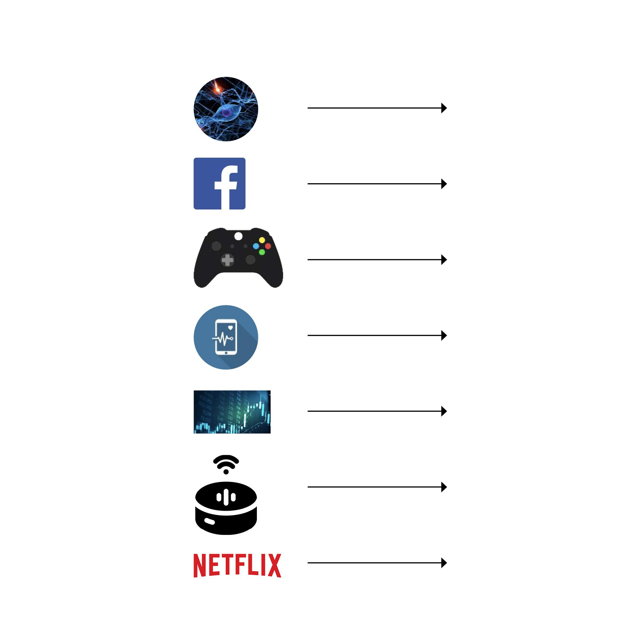
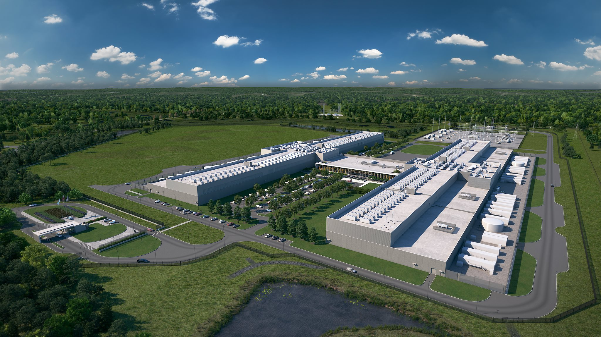
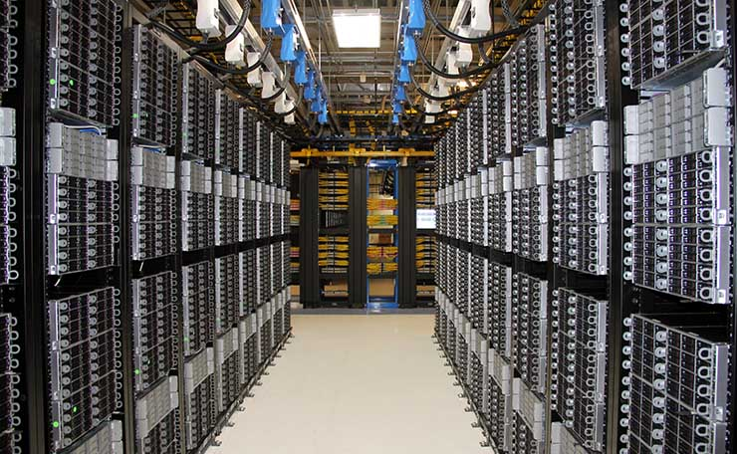
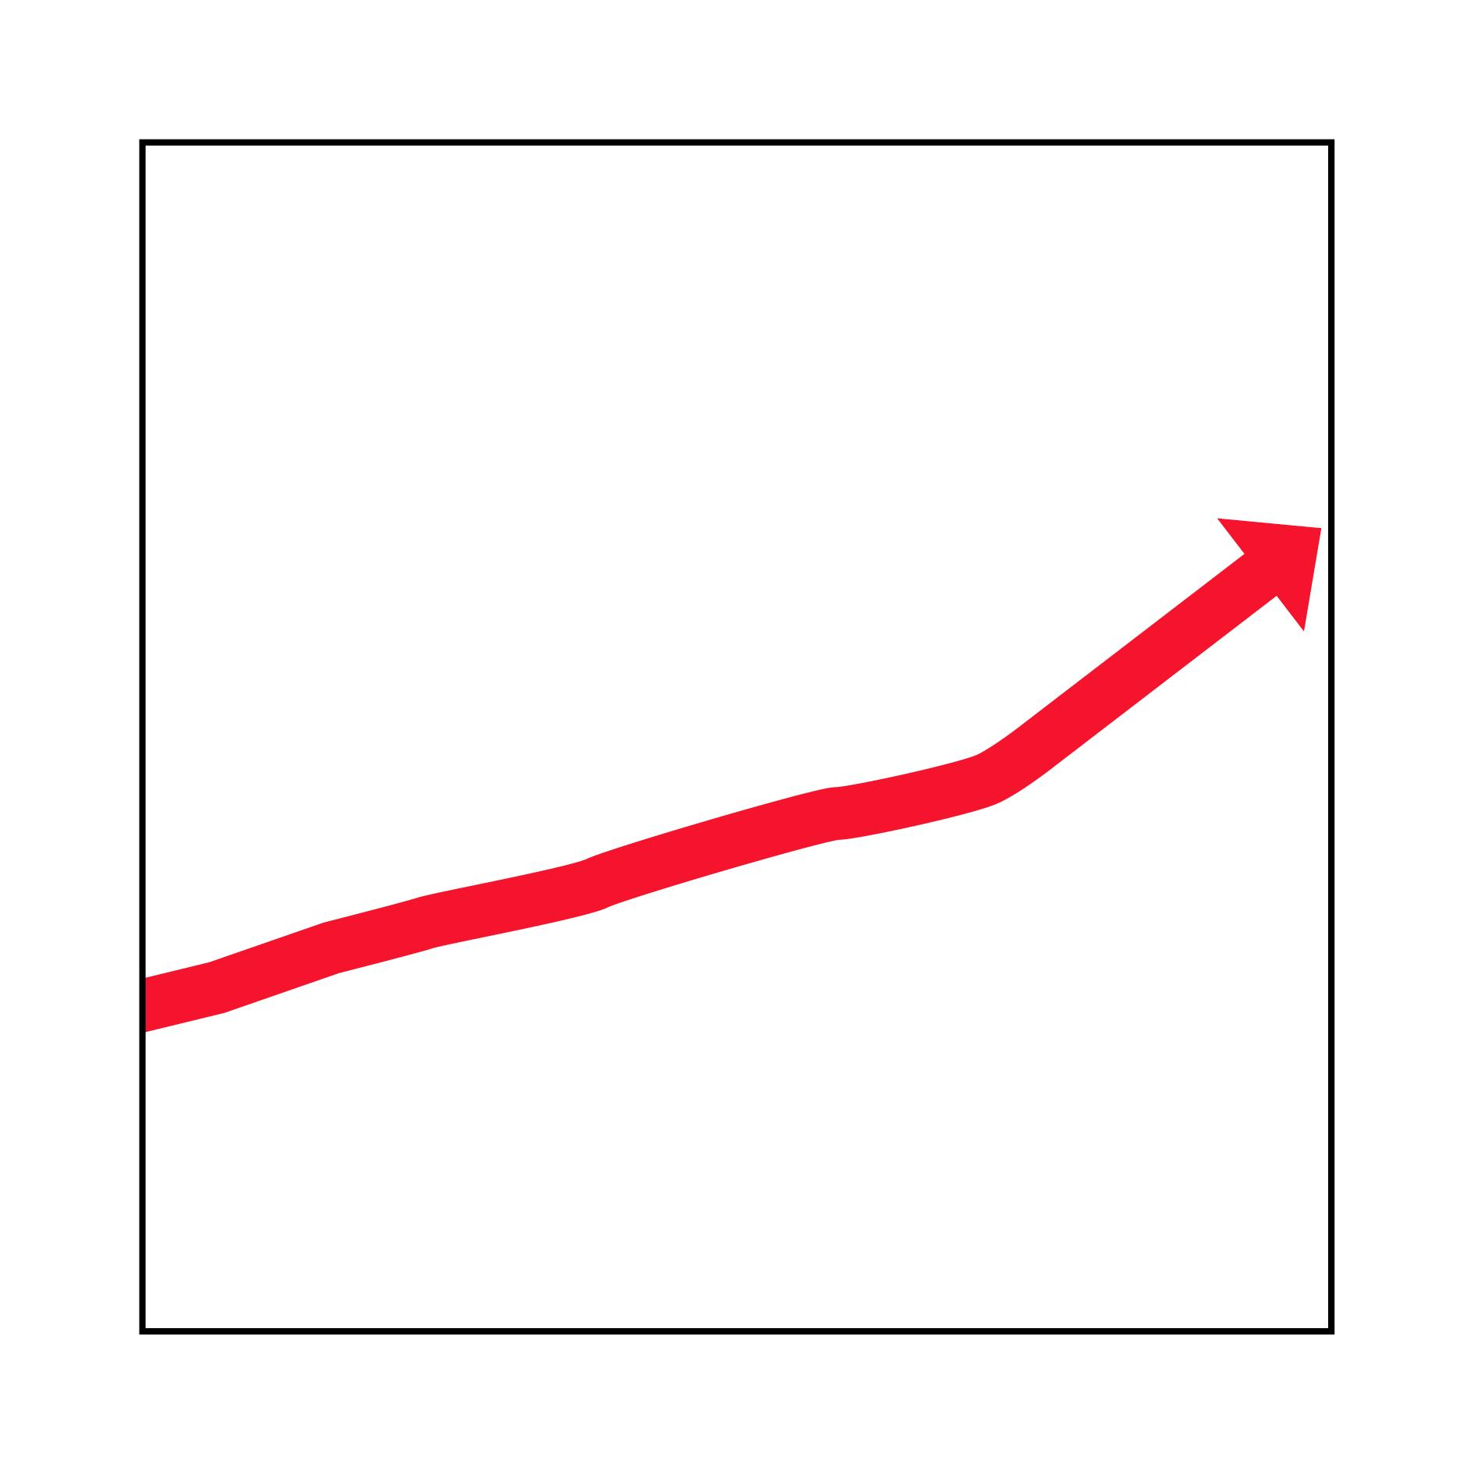
Trend Data-Centric Applications
Datacenters (“hyper-scale”)
+network
Source: Facebook
Traffic
Growth
Interconnecting networks: a critical infrastructure of our digital society.
1
Notes:
The interconnecting networks have become a critical infrastructure of our digital society.

Slide 3
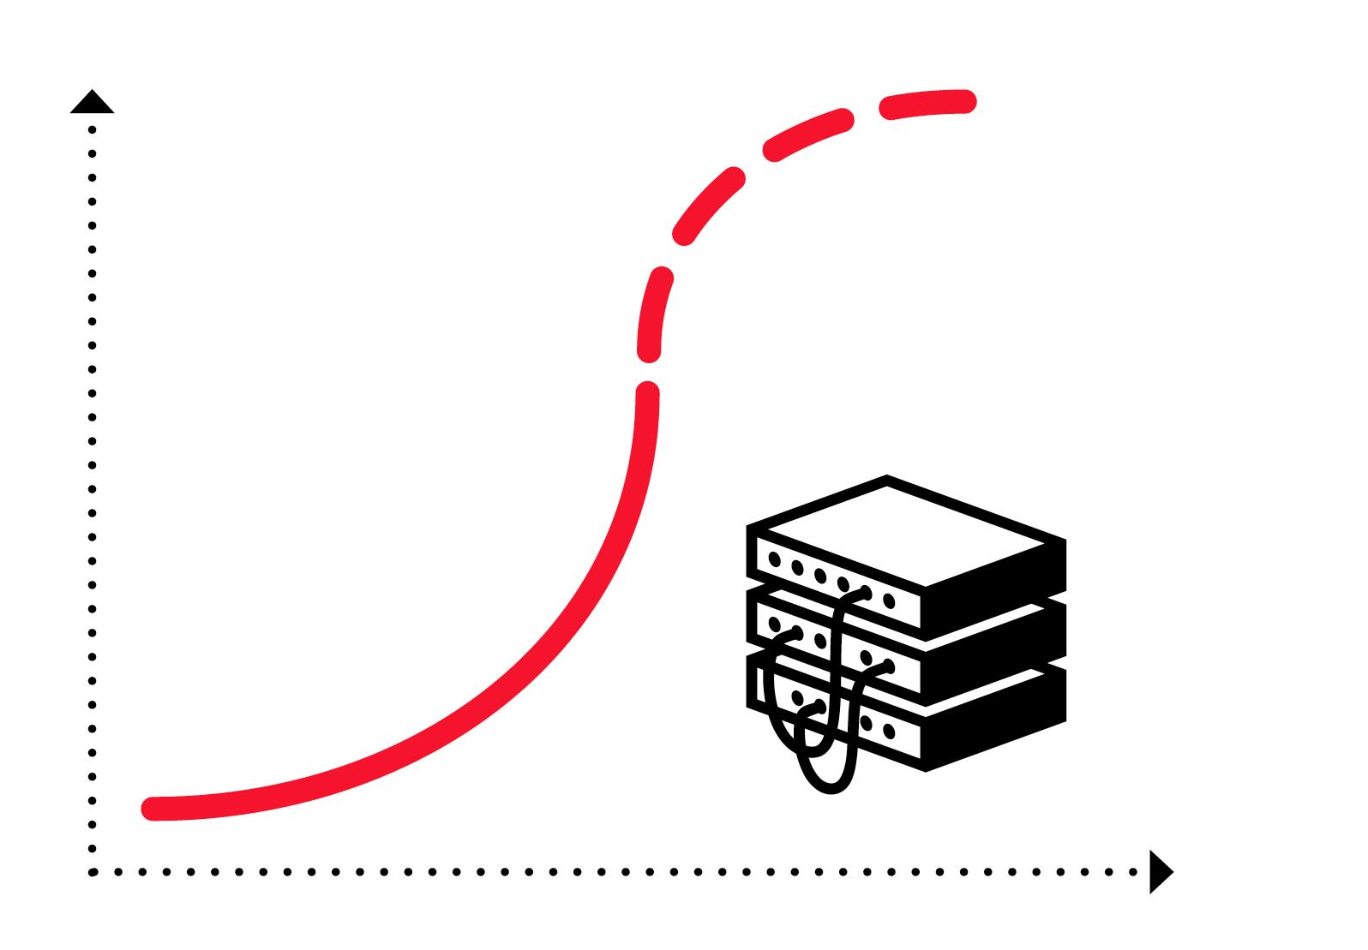
The Problem Huge Infrastructure, Inefficient Use
⇢ Network equipment reaching
capacity limits
⇀ Transistor density rates stalling
⇀ “End of Moore‘s Law in networking” [1]
⇢ Hence: more equipment,
larger networks
⇢ Resource intensive and:
inefficient
[1] Source: Microsoft, 2019
Gbps/€
Time
Annoying for companies,
opportunity for researchers
Notes:
This may be annoying for companies, it introduces a great opportunity for researchers.

Slide 4
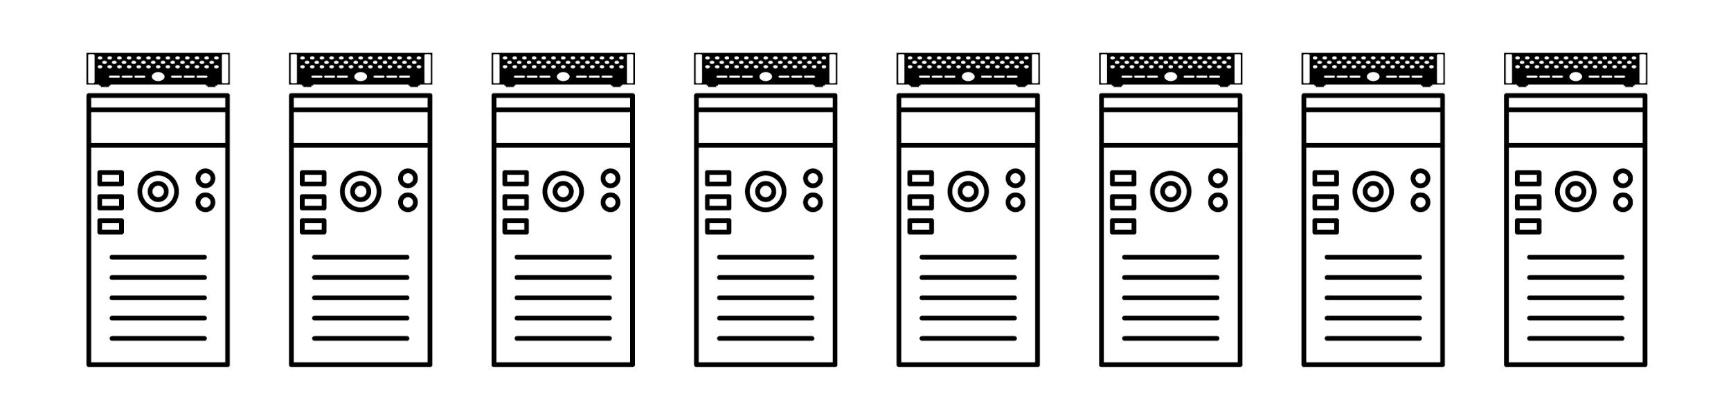
Root Cause Fixed and Demand-Oblivious Topology
How to interconnect?
3
Notes:
A route cause for this inefficiency is related to how we interconnect these distributed systems.

Slide 5
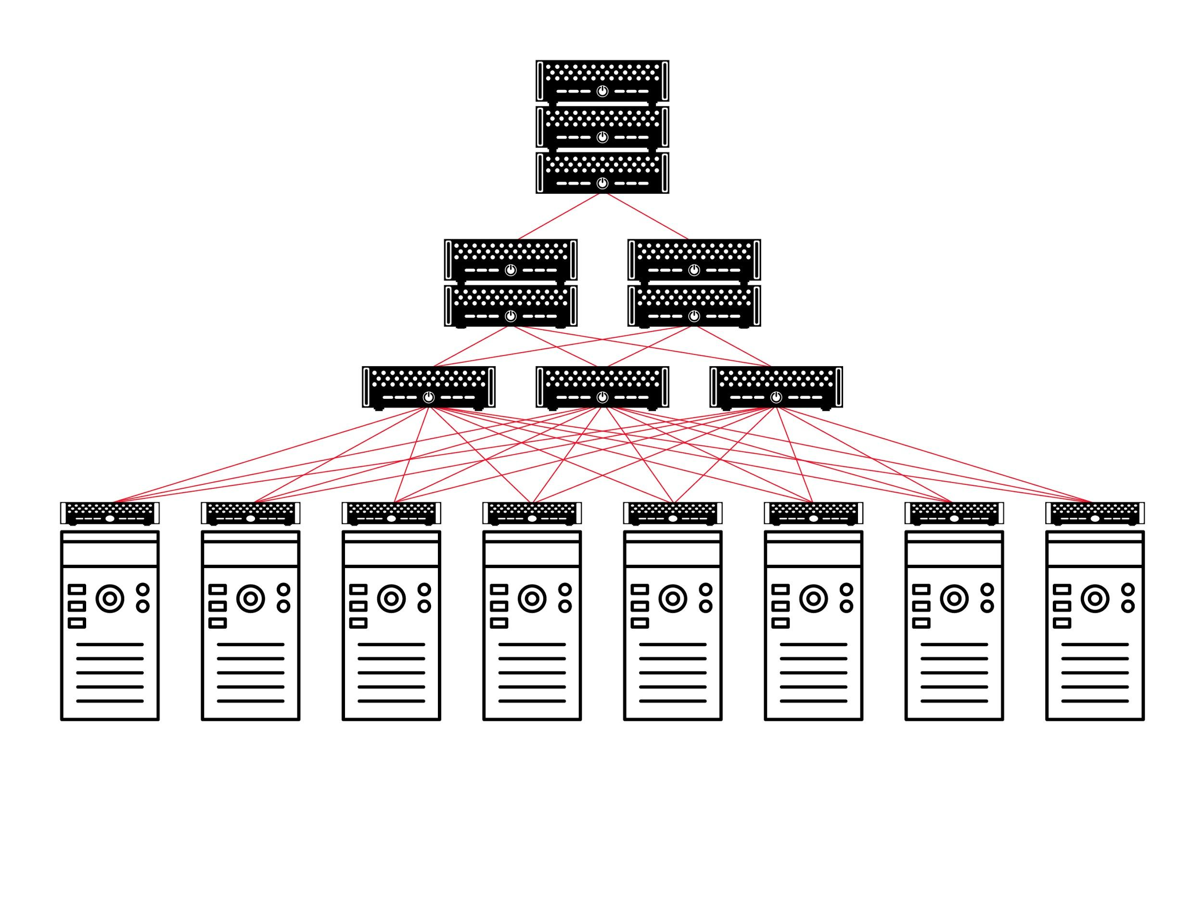
Root Cause Fixed and Demand-Oblivious Topology
Many flavors,
but in common: fixed and oblivious to actual demand.
3
Notes:
Today, many different network toplogies are used in datacenters, such as this one.
However, they all have in common that they are fixed and oblivious to the actual demand.

Slide 6
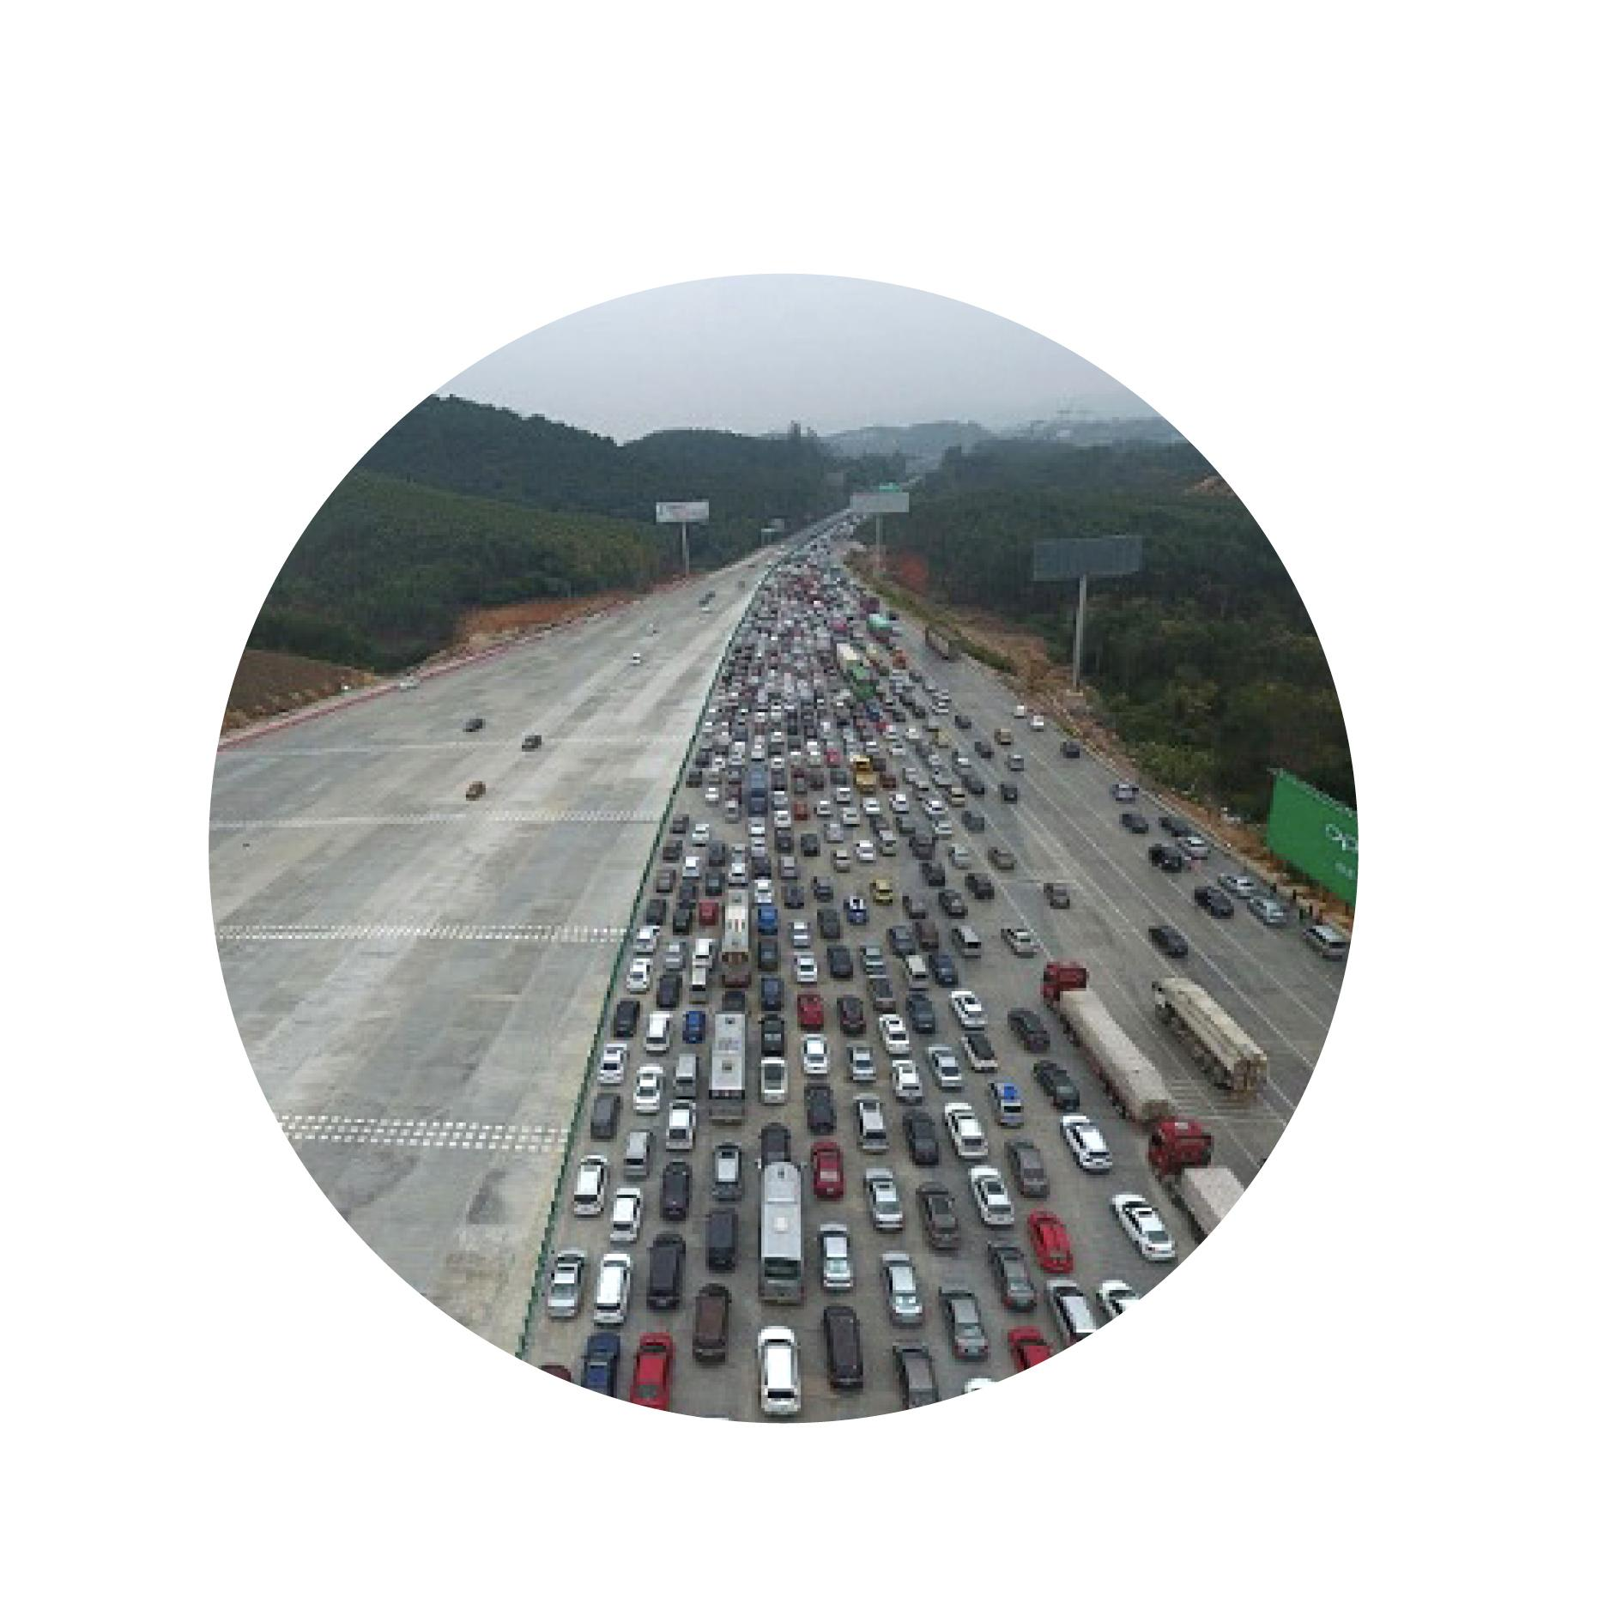
Root Cause Fixed and Demand-Oblivious Topology
Many flavors,
but in common: fixed and oblivious to actual demand.
Highway which ignores actual traffic: frustrating!
3
Notes:
You can think of it like a highway which ignores the actual traffic: it can be frustrating.
Here it would be much better if the other lanes could be used as well. And maybe in the evening the other way round.

Slide 7
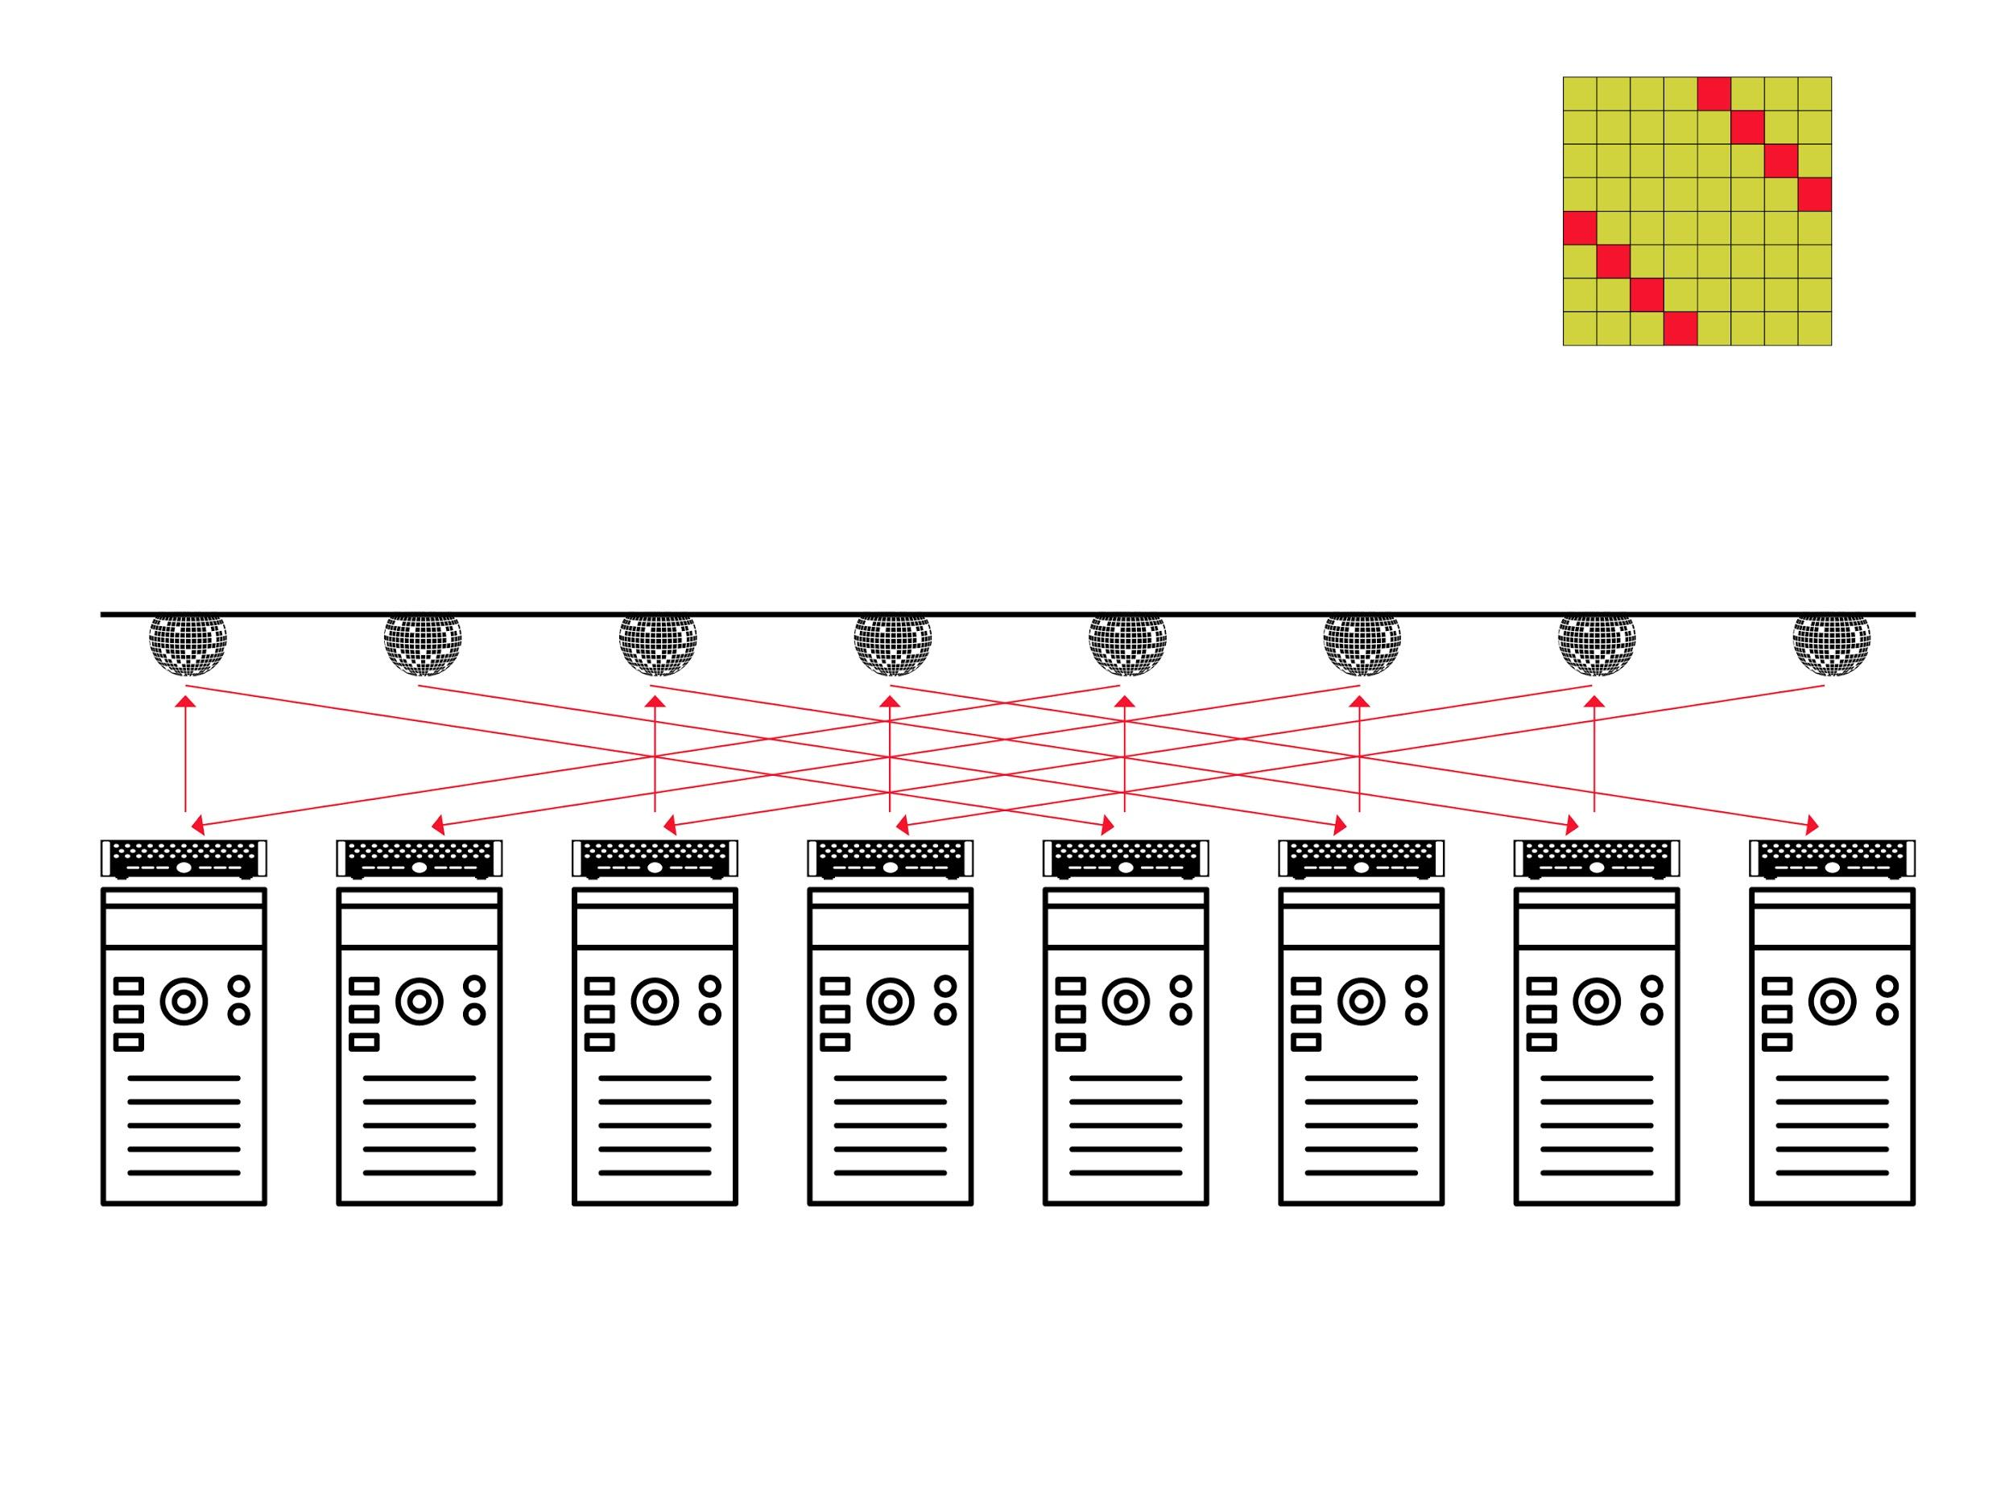
Our Vision Flexible and Demand-Aware Topologies
4
Notes:
My vision is that networks should become flexible and demand-aware.

Slide 8
Our Vision Flexible and Demand-Aware Topologies
e.g.,
mirrors
new flexible
interconnect
1
2
3
4
5
6
7
8
4
Notes:
e.g., based on mirrors.

Slide 9
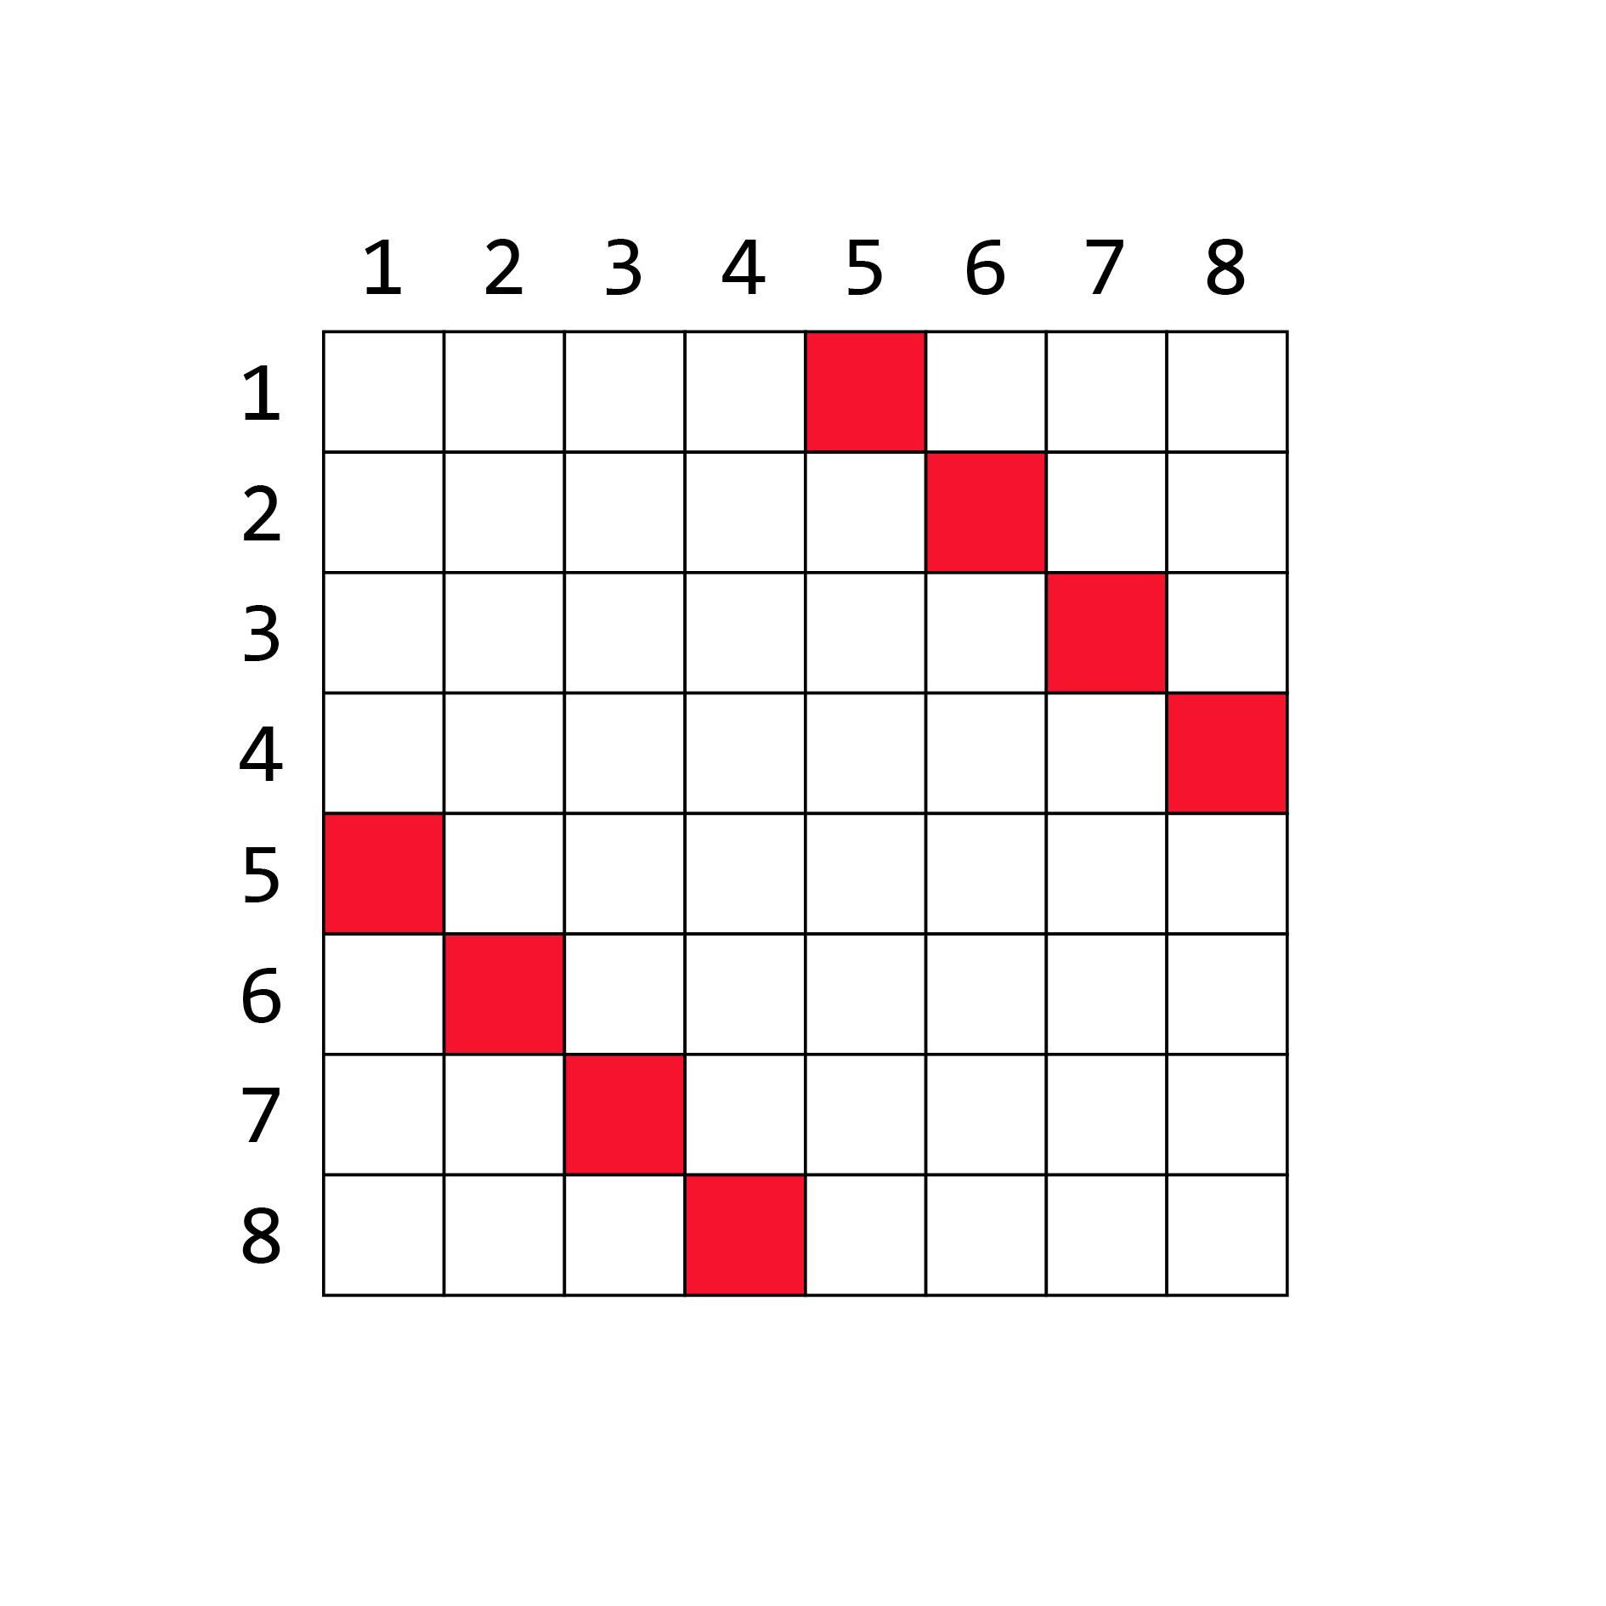
Our Vision Flexible and Demand-Aware Topologies
demand
matrix:
e.g.,
mirrors
new flexible
interconnect
1
2
3
4
5
6
7
8
4
Notes:
For example, if the demand matrix looks like this: 1 communicates to 5, 2 to 6, etc…

Slide 10
Our Vision Flexible and Demand-Aware Topologies
demand
matrix:
Matches demand
e.g.,
mirrors
new flexible
interconnect
1
2
3
4
5
6
7
8
4
Notes:
… it makes sense to interconnect the servers like this.
This perfectly matches the demand.

Slide 11
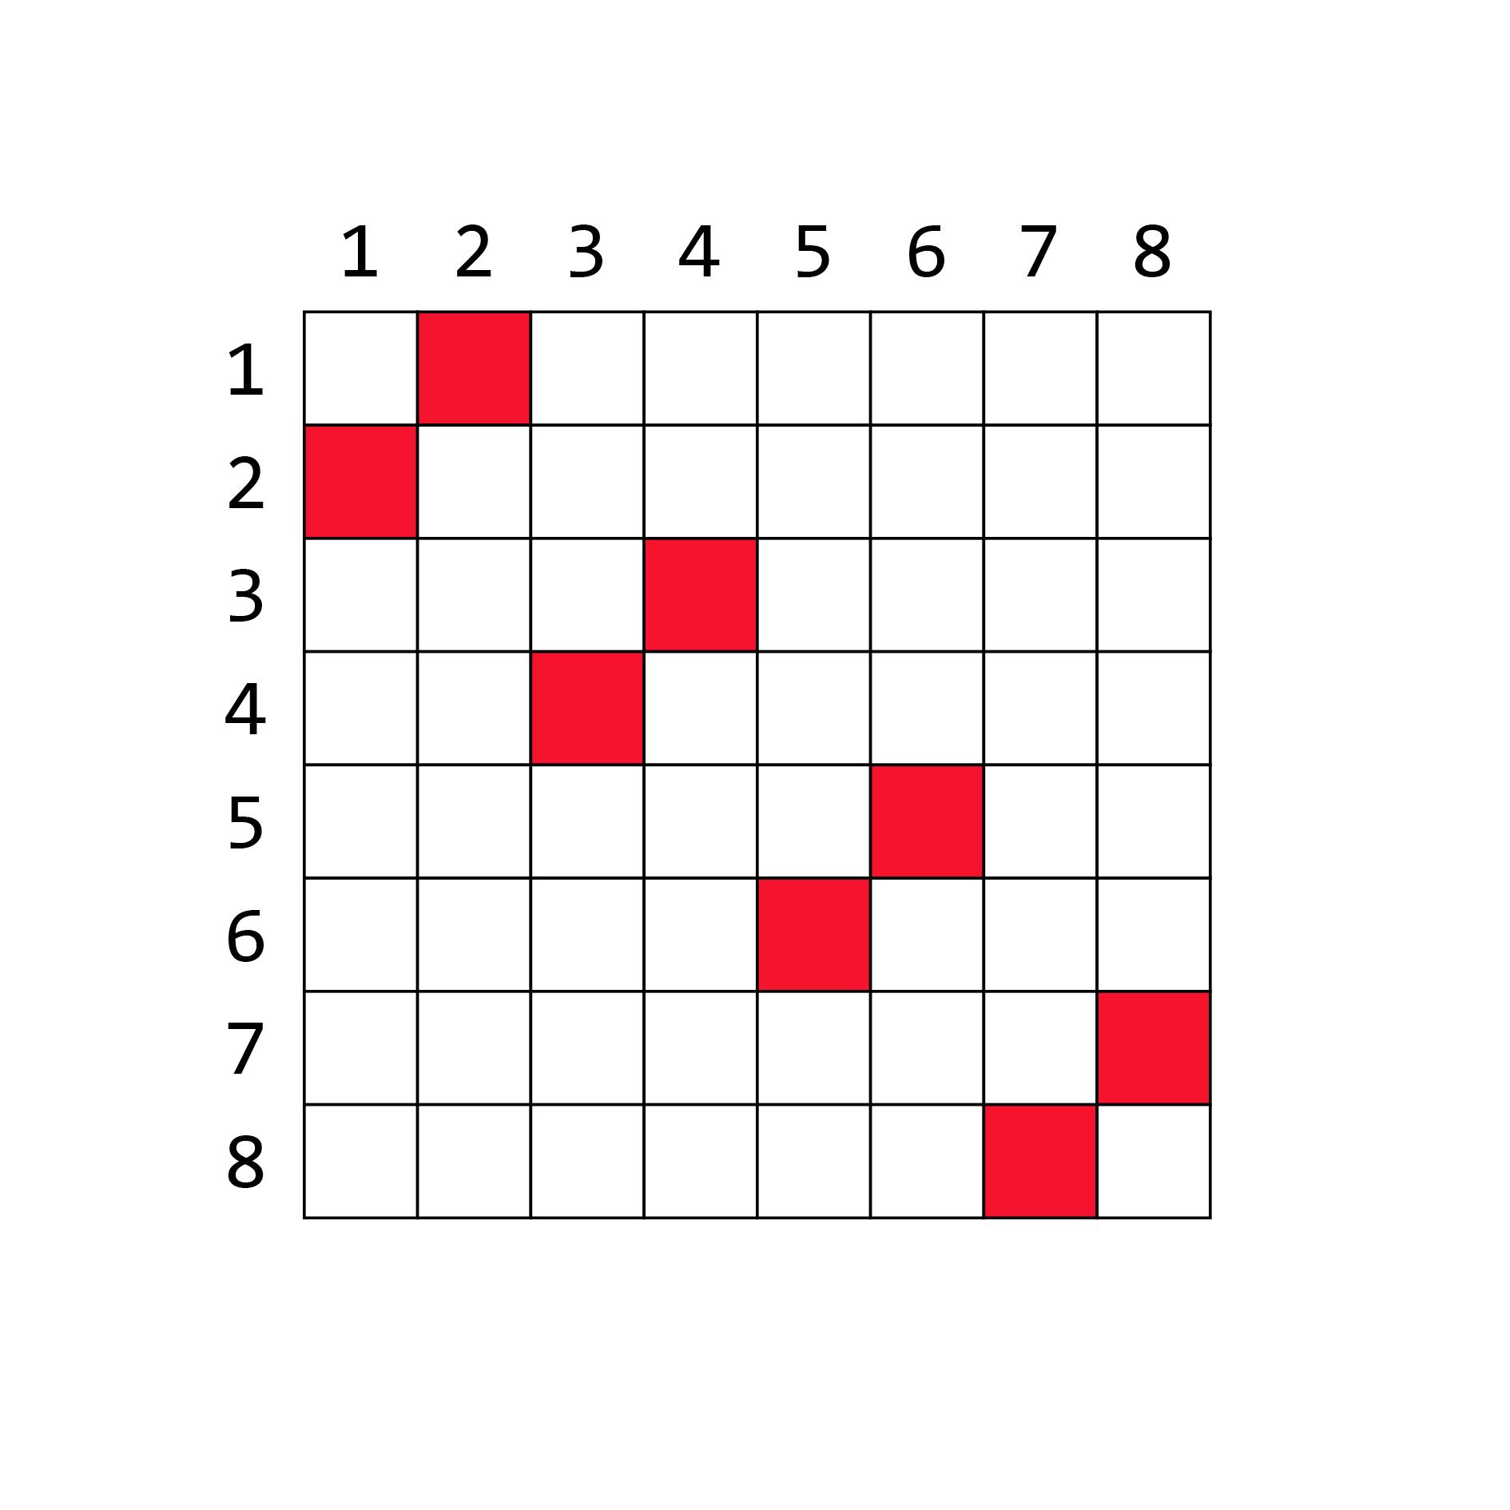
Our Vision Flexible and Demand-Aware Topologies
new
demand:
e.g.,
mirrors
new flexible
interconnect
1
2
3
4
5
6
7
8
4
Notes:
If the demand changes to this…

Slide 12
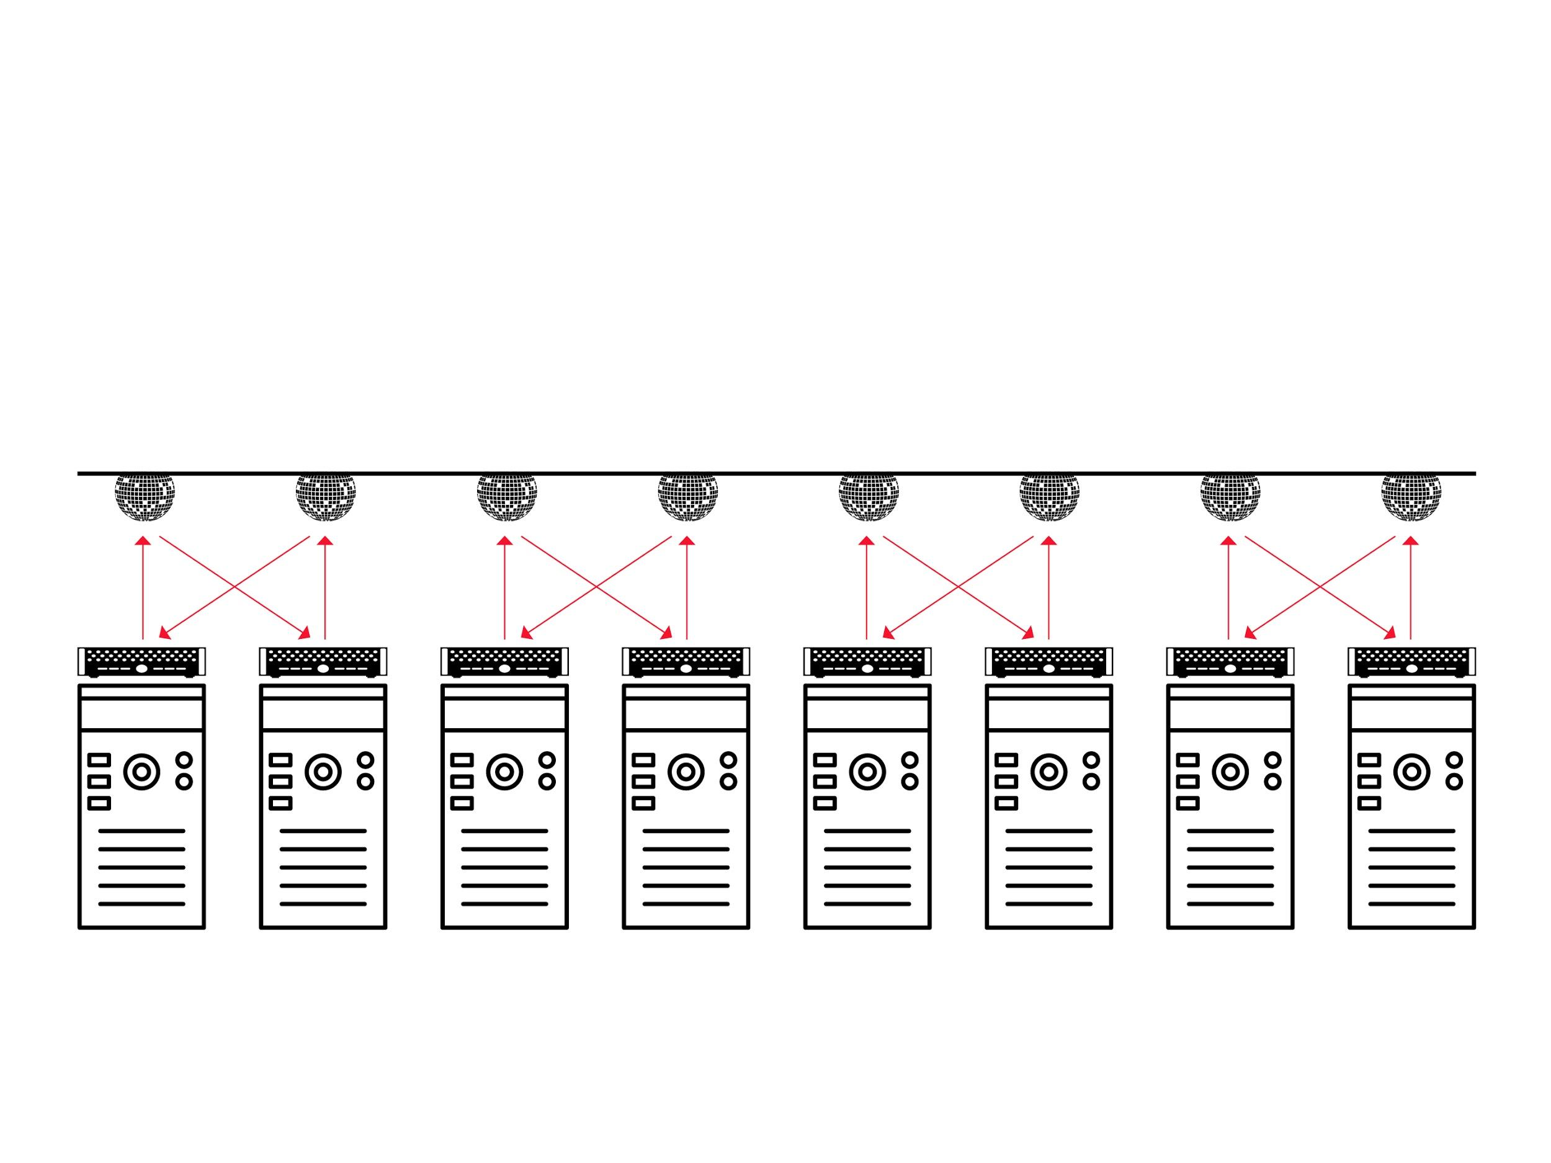
Our Vision Flexible and Demand-Aware Topologies
new
demand:
Matches demand
e.g.,
mirrors
new flexible
interconnect
1
2
3
4
5
6
7
8
4
Notes:
… the topology should be changed as well, to match the demand again.

Slide 13

Our Vision Flexible and Demand-Aware Topologies
new
demand:
Self-Adjusting
Networks
e.g.,
mirrors
new flexible
interconnect
1
2
3
4
5
6
7
8
4
Notes:
This is the idea of self-adjusting networks: they dynamically reconfigure over time, in a demand-aware manner.

Slide 14
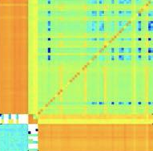
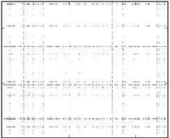
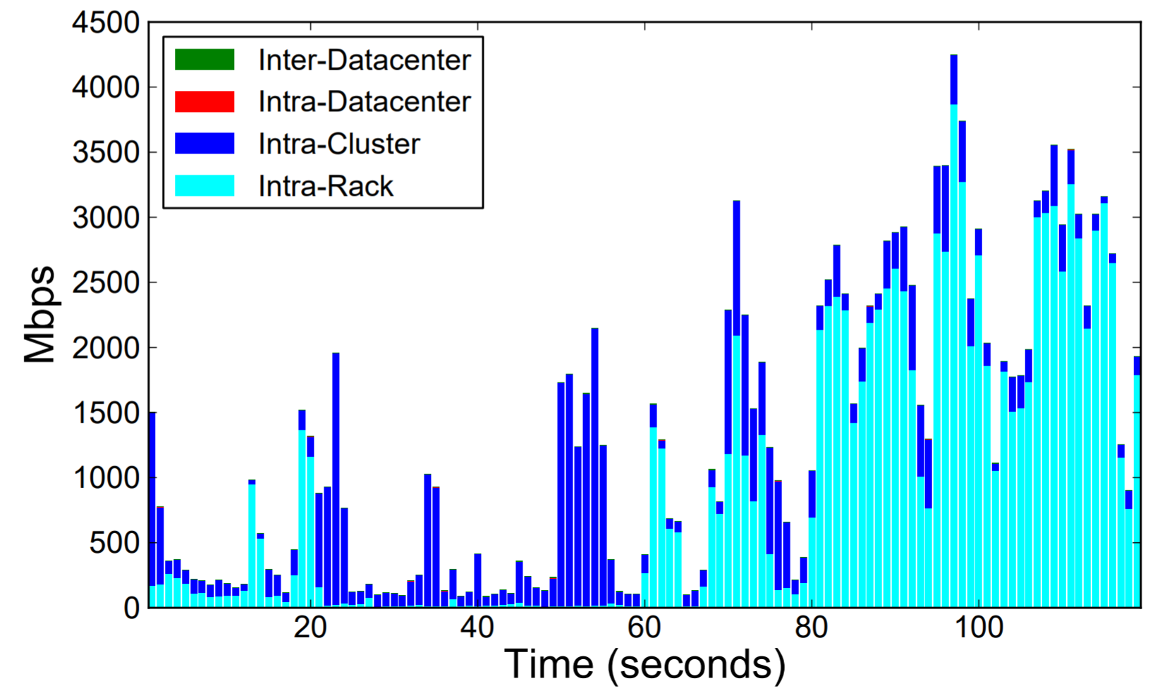
Our Motivation Much Structure in the Demand
Empirical studies:
traffic matrices sparse and skewed
traffic bursty over time
Facebook
Microsoft
Facebook
sources
sources
Mbps
destinations
destinations
Time (seconds)
My hypothesis: can be exploited.
5
Notes:
My motivation for this project is that there is much structure in the demand indeed.
Empirical studies show that traffic matrices are sparse and skewed, and traffic bursty over time.
My hypothesis is that this can be exploited.

Slide 15
Recent Representation of Trace Structure: Complexity Map
DB
Web
Had
ML
CNS
Multi
Grid
pF
NN
Griner et al., SIGMETRICS 2020

Slide 16
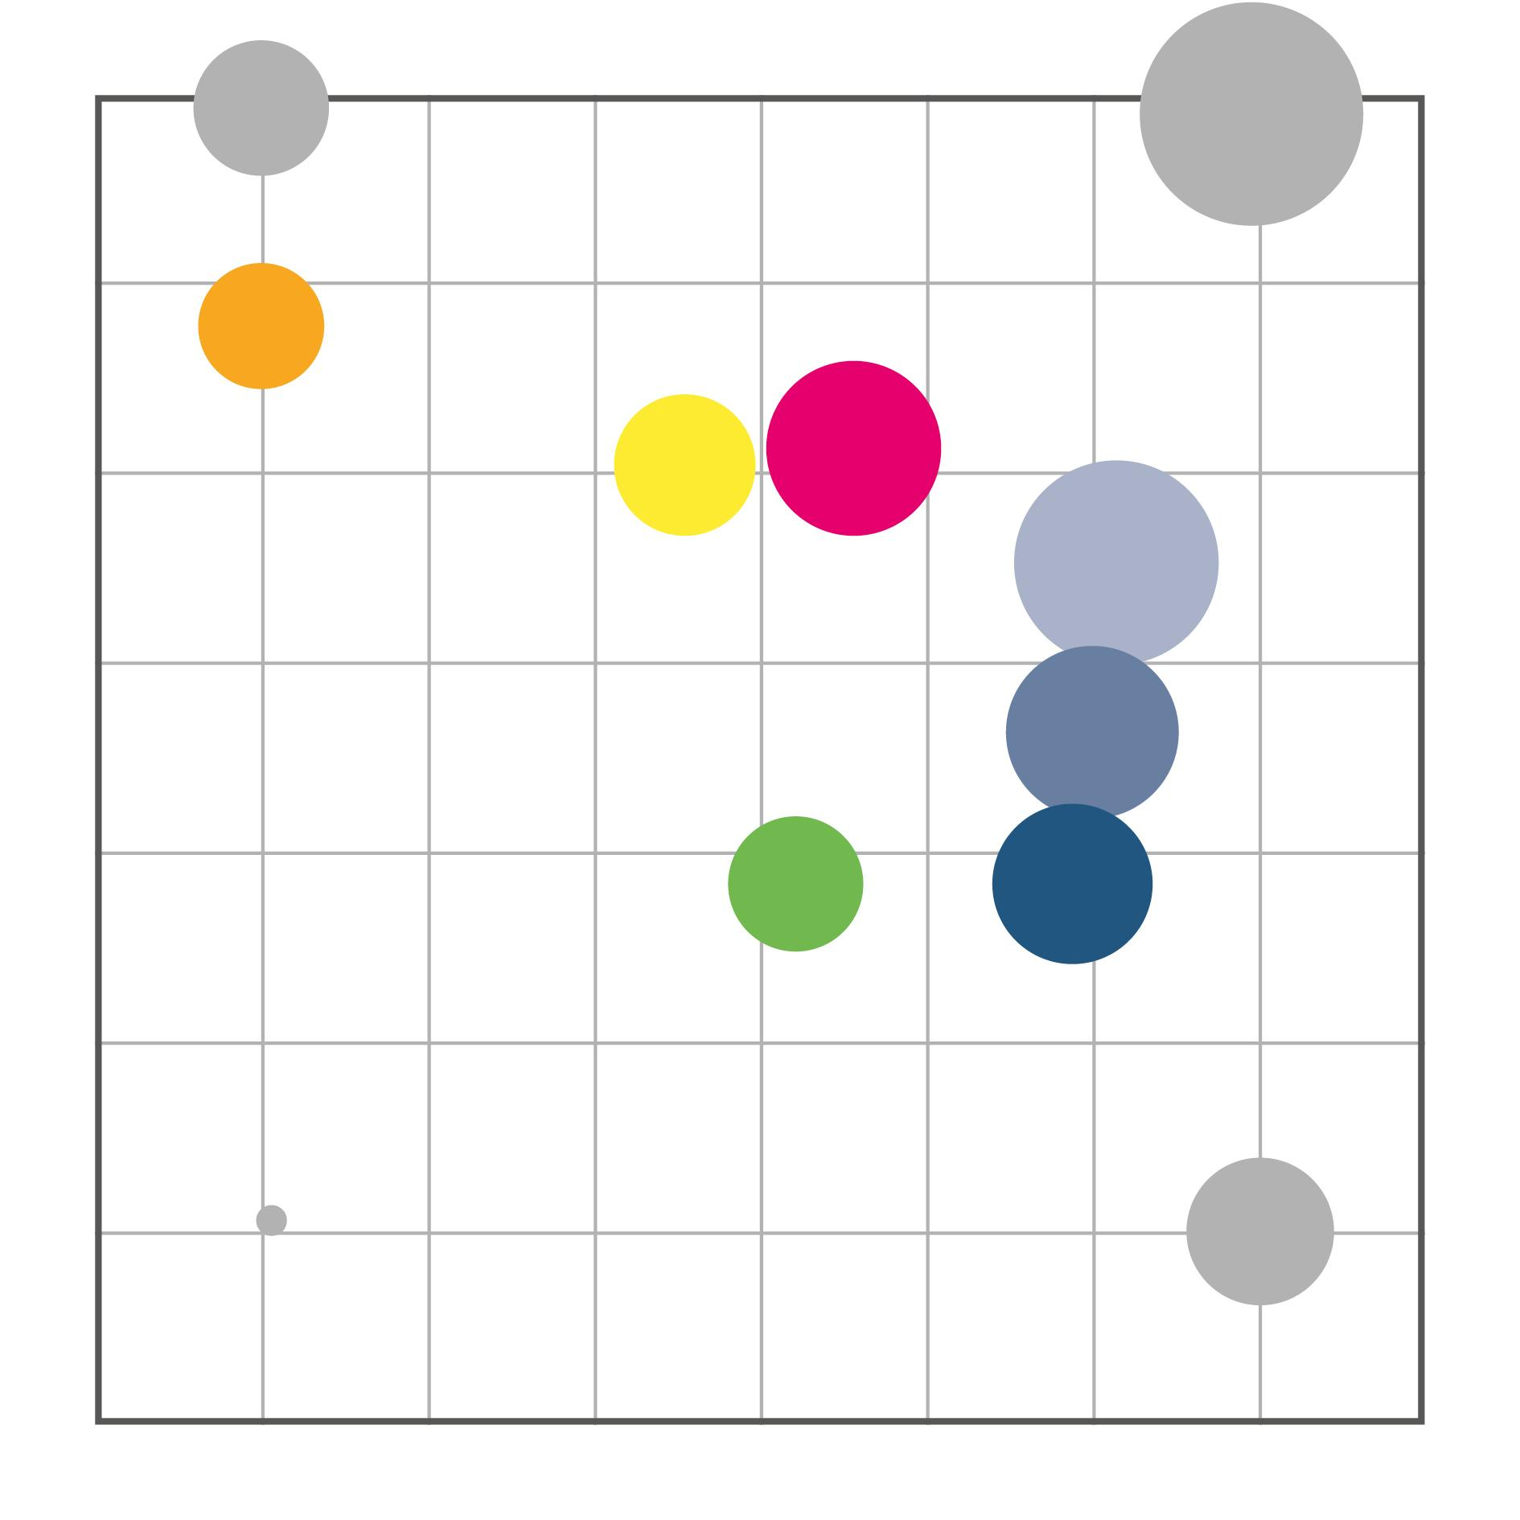
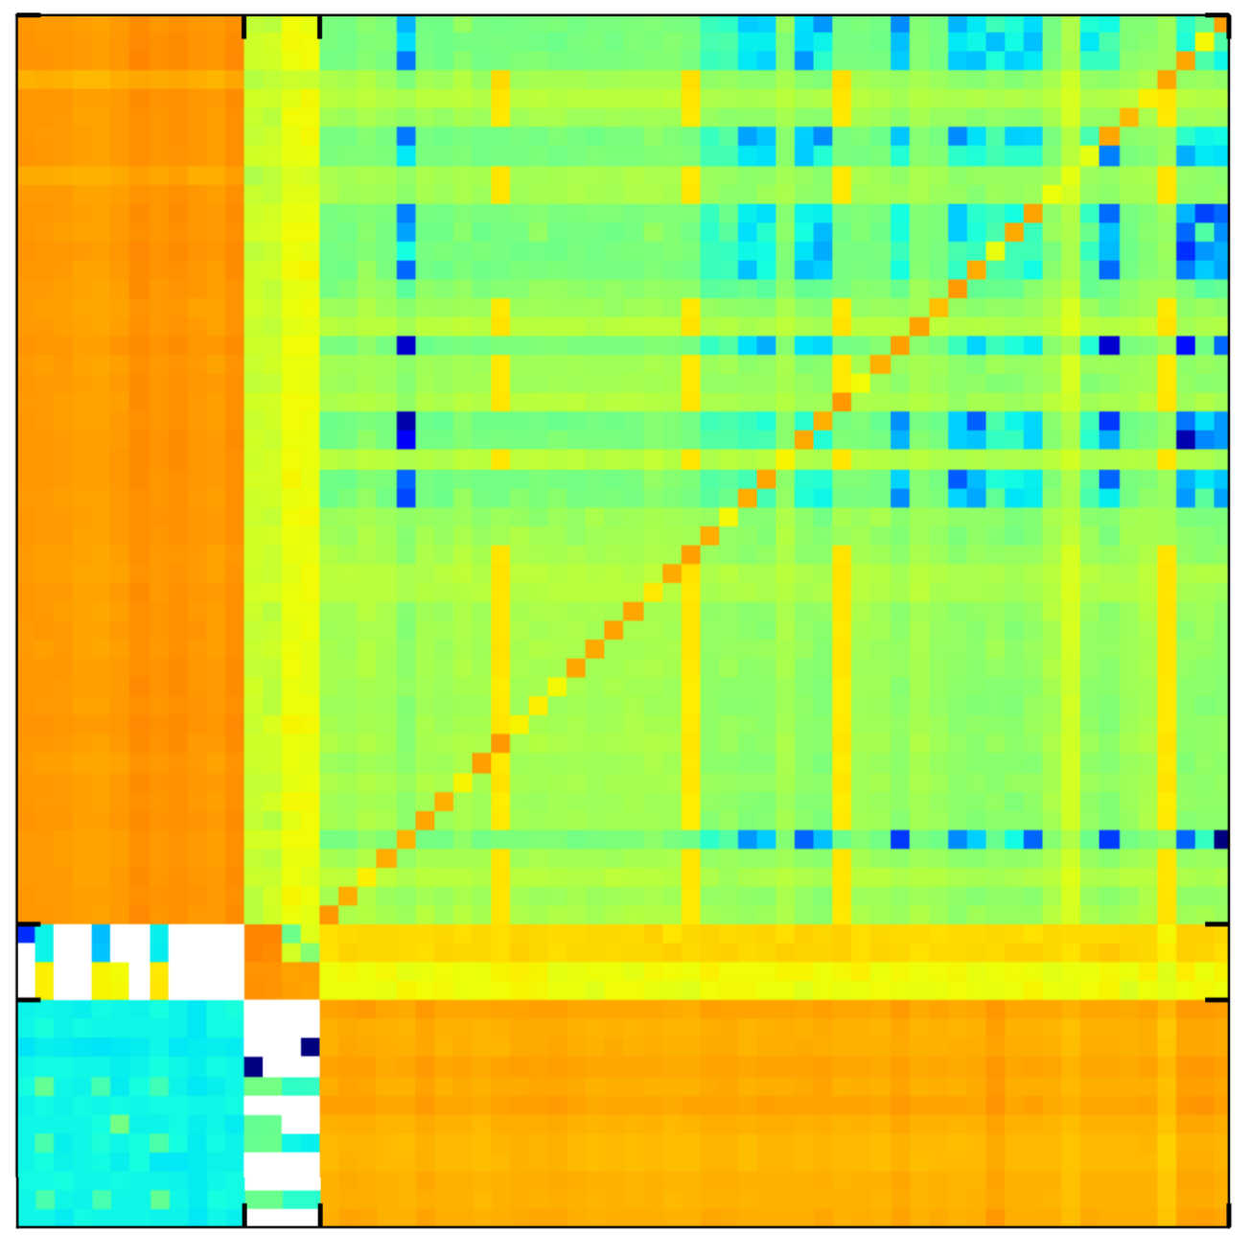
Recent Representation of Trace Structure: Complexity Map
bursty
uniform
pF
CNS
ML
DB
DB
Web
Web
non-temporal complexity
Multi
Grid
Had
Had
Different structures!
ML
NN
bursty & skewed
CNS
skewed
Multi
Grid
temporal complexity
pF
NN
Griner et al., SIGMETRICS 2020

Slide 17
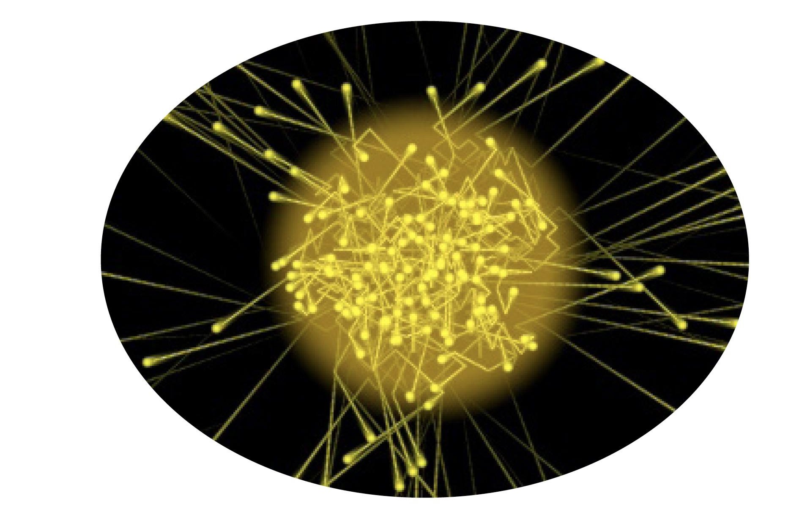
Sounds Crazy?
Emerging Enabling Technology.
H2020:
“Photonics one of only five
key enabling technologies for future prosperity.”
US National Research Council:
“Photons are the new
Electrons.”
Photonics
7
Notes:
Generally, photonics is seen as one of the key enabling technologies of our future prosperity, both in the EU and in the US.

Slide 18
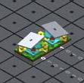
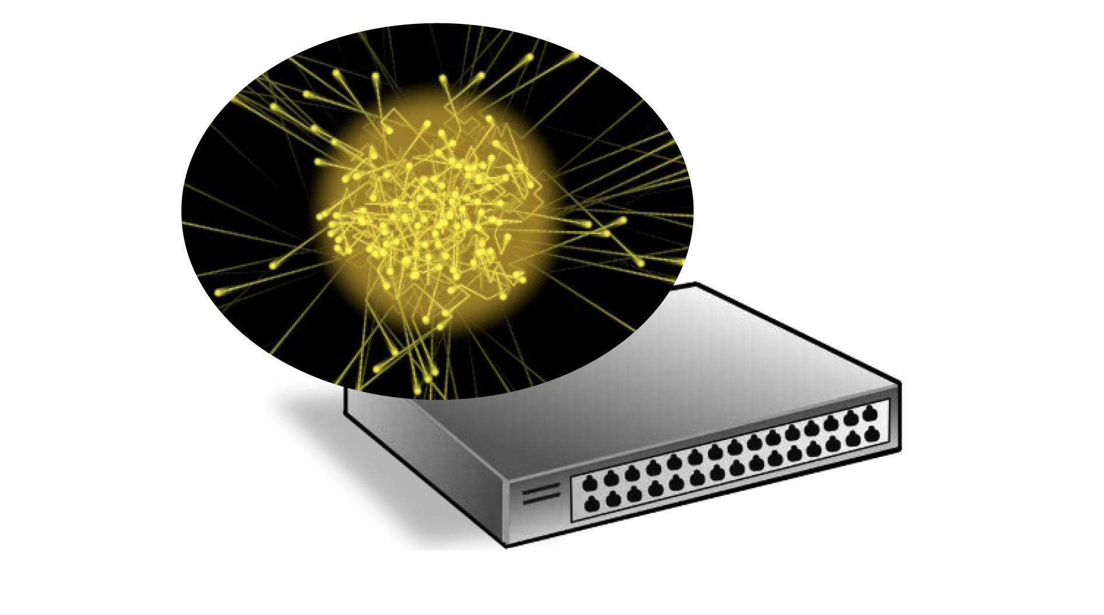
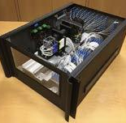
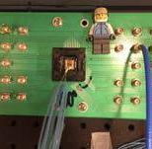
Enabler Novel Reconfigurable Optical Switches
⇢ Spectrum of prototypes
⇀ Different sizes, different reconfiguration times
⇀ From our last year’s ACM SIGCOMM workshop OptSys
Prototype 1
Prototype 2
Prototype 3
8
Notes:
More specifically, the enabler for our project are reconfigurable optical switches.
There is currently a spectrum of prototypes emerging: these prototypes have different sizes, different reconfiguration times, etc.
Here are some examples from the SIGCOMM workshop we organized last month.

Slide 19
Example Optical Circuit Switch
⇢ Optical Circuit Switch rapid adaption of physical layer
⇀ Based on rotating mirrors
Lenses
Fixed
Mirror
Rotate Mirror
Mirrors on Motors
Optical Circuit Switch By Nathan Farrington, SIGCOMM 2010
9
Notes:
More specifically, the enabler for our project are reconfigurable optical switches.
There is currently a spectrum of prototypes emerging: these prototypes have different sizes, different reconfiguration times, etc.
Here are some examples from the SIGCOMM workshop we organized last month.

Slide 20
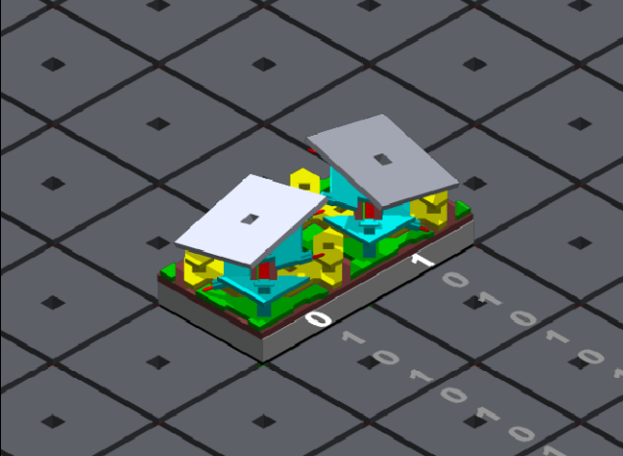
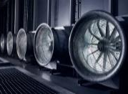
The Big Picture
Flexibility
Self-Adjusting
Networks
New!
Efficiency
Structure
More!
Now is the time!
10
Notes:
In a nutshell, the idea of this project is to exploit these new technological flexibilities, as well as the structure in the demand, to design self-adjusting networks, and improve efficiency. Now is the right time for this project:
it is possible to have impact as the community is currently re-achritecting networks anyways.

Slide 21
The Big Picture
Flexibility
Self-Adjusting
Networks
New!
Efficiency
Structure
More!
Our goal: Develop the theoretical foundations of demand-aware, self-adjusting networks.
Now is the time!
10
Notes:
Our goal is to develop the theoretical foundations of such demand-aware networks, and a framework which comes with provable guarantees.

Slide 22


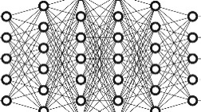
Unique Position Demand-Aware, Self-Adjusting Systems
Everywhere, but mainly
in software
Our focus:
in hardware
Algorithmic trading
vs
Recommender systems
Neural networks
11
Notes:
The project assumes an interesting position: today there are many self-adjusting systems, e.g., in algorithmic trading, recommender systems, or also neural networks of course.
These systems are in software only.
In contrast, we aim to build self-adjusting systems in hardware, on the physical layer.

Slide 23
The Natural Question:
Given This Structure, What Can Be Achieved?
Metrics and Algorithms?
A first insight: entropy of the demand.
12
Notes:
Of course, we are particularly interested in what can be achieved in self-adjusting networks.
To this end, we want to develop metrics for self-adjusting networks which depend on the demand, as well as algorithms.
Here we have some first insights that the entropy of the demand can serve as a useful metric for self-adjusting networks.

Slide 24
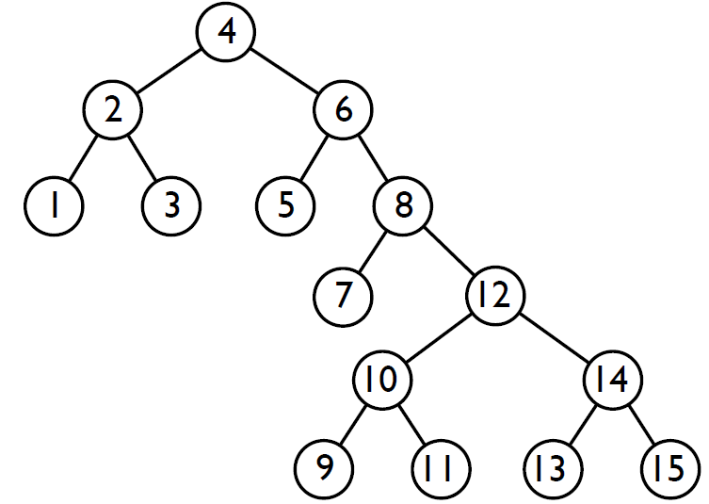
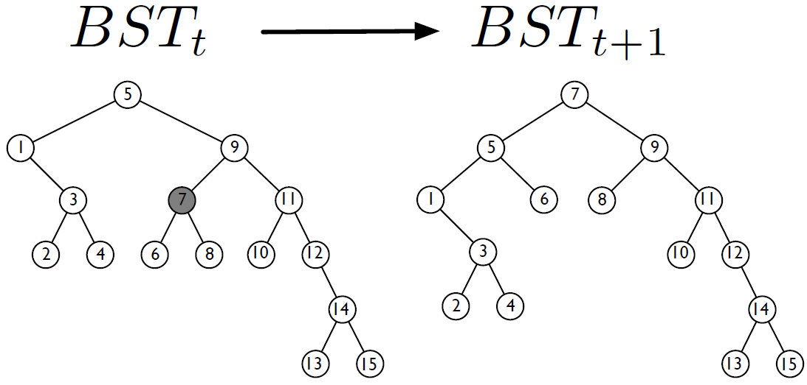
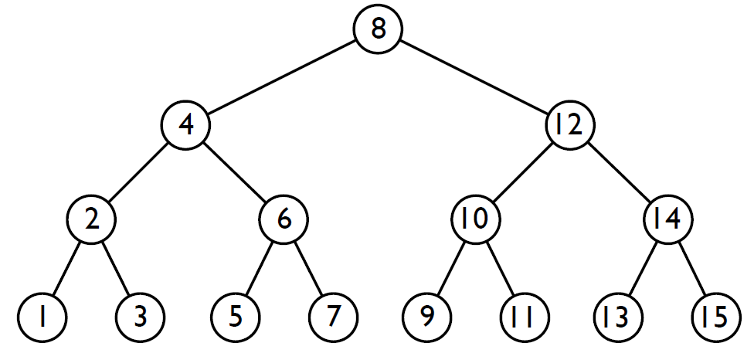
Our Insight: Connection to Datastructures
Traditional BST
Demand-aware BST
Self-adjusting BST
More structure: improved access cost
13
Notes:
One approach in this project is to exploit a connection to self-adjusting datastructures.
We know today that the more structure there is in an access pattern to a datastructure, the more we can improve the access cost if we make the datastructure more demand-aware and self-adjusting.

Slide 25
Our Insight: Connection to Datastructures & Coding
Traditional BST
(Worst-case coding)
Demand-aware BST
(Huffman coding)
Self-adjusting BST
(Dynamic Huffman coding)
More structure: improved access cost / shorter codes
13
Notes:
Similar benefits exist also for coding, by the way.

Slide 26
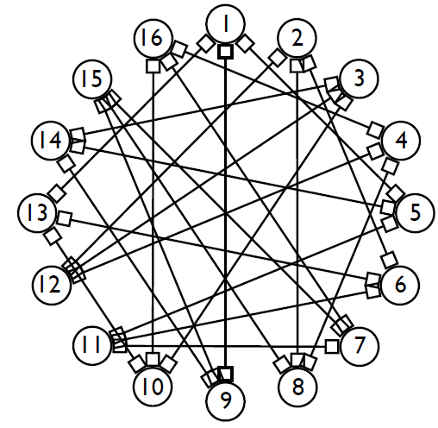
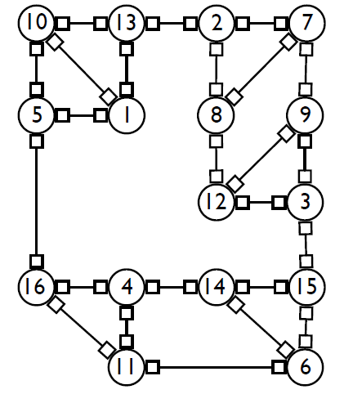
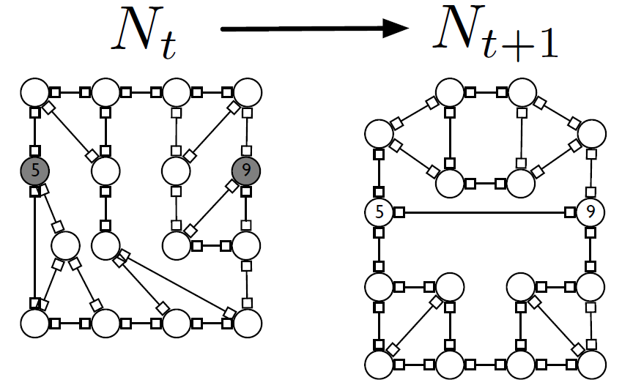
Our Insight: Connection to Datastructures & Coding
Traditional BST
(Worst-case coding)
Demand-aware BST
(Huffman coding)
Self-adjusting BST
(Dynamic Huffman coding)
More structure: improved access cost / shorter codes
Similar benefits?
13
Notes:
With our research we want to investigate whether similar benefits can be obtained in self-adjusting networks as well.

Slide 27
Our Insight: Connection to Datastructures & Coding
Traditional BST
(Worst-case coding)
Demand-aware BST
(Huffman coding)
Self-adjusting BST
(Dynamic Huffman coding)
More than
an analogy!
More structure: improved access cost / shorter codes
Similar benefits?
13
Notes:
However, this is more than an analogy.

Slide 28
Our Insight: Connection to Datastructures & Coding
Traditional BST
(Worst-case coding)
Demand-aware BST
(Huffman coding)
Self-adjusting BST
(Dynamic Huffman coding)
More than
an analogy!
log n
entropy
entropy
rate
Generalize methodology:
... and transfer entropy bounds and algorithms of data-structures to networks.
log n
entropy
entropy
rate
First result:
Demand-aware networks of asymptotically optimal route lengths.
Reduced expected route lengths!
13
Notes:
Actually, we also have first results on how we can exploit algorithms from coding and datastructures to design self-adjusting networks which match these lower bounds and are hence asymptotically optimal.

Slide 29
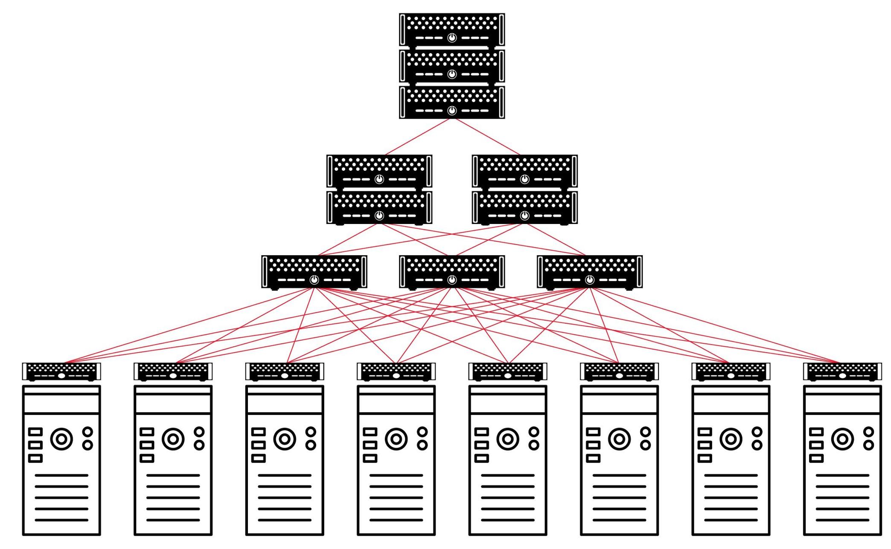
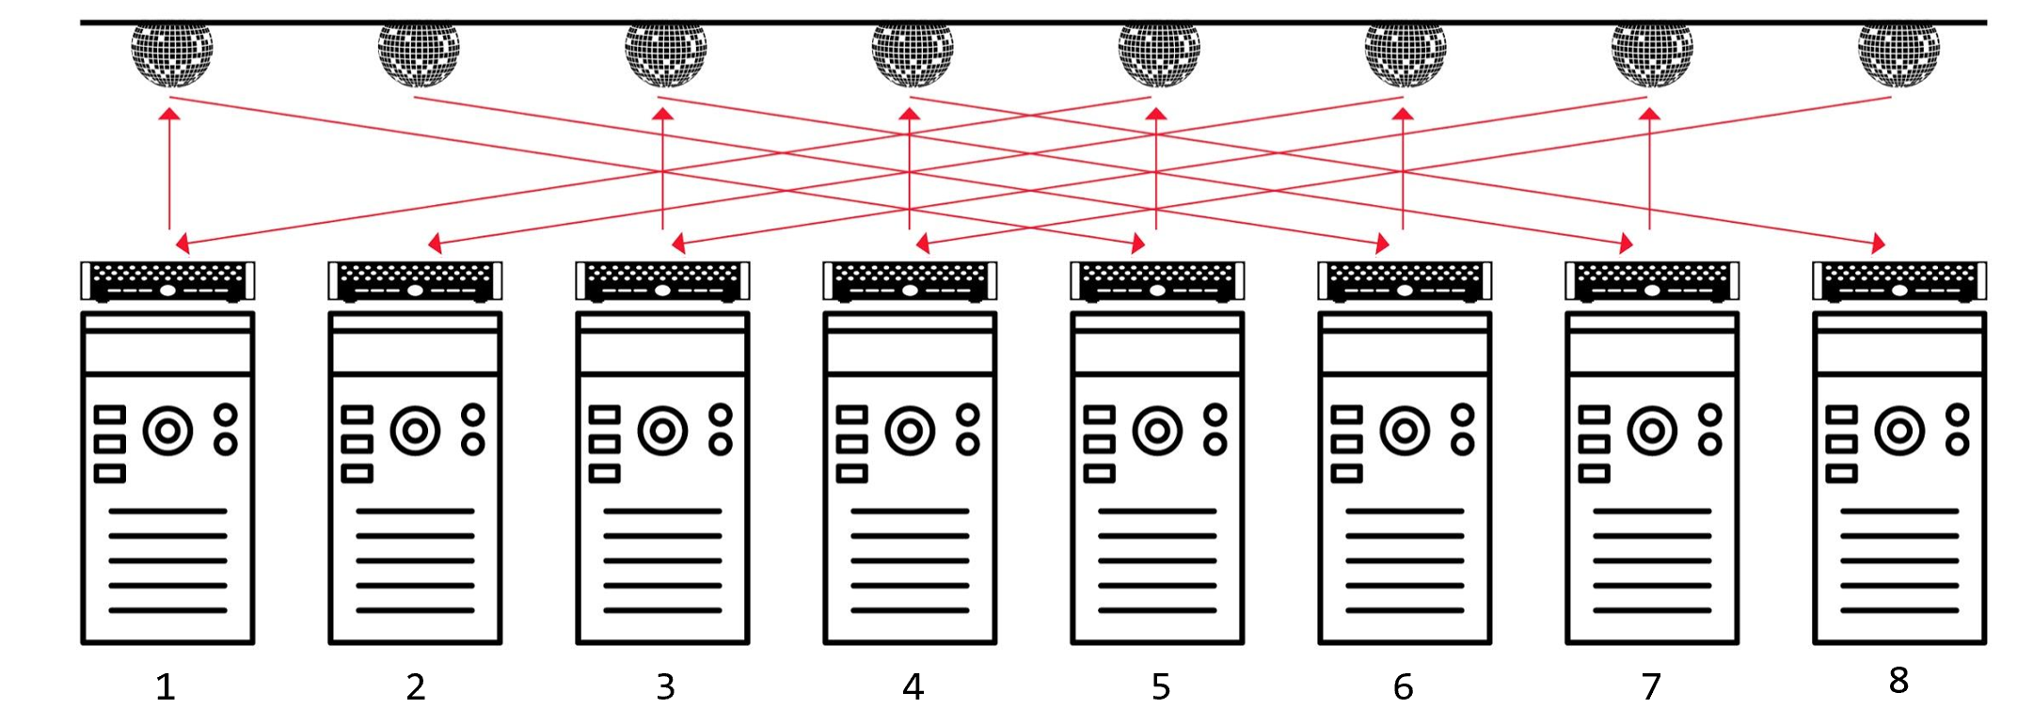
It is more complicated…
⇀ Self-adjusting networks may be really useful to serve large
flows (elephant flows): avoiding multi-hop routing
vs
6 hops
1 hop
14

Slide 30
It is more complicated…
⇀ Self-adjusting networks may be really useful to serve large
flows (elephant flows): avoiding multi-hop routing
bandwidth
tax!
vs
6 hops
1 hop
14

Slide 31
It is more complicated…
⇀ Self-adjusting networks may be really useful to serve large
flows (elephant flows): avoiding multi-hop routing
⇀ However, requires optimization and adaption, which takes time
bandwidth
tax!
vs
6 hops
1 hop
14

Slide 32
It is more complicated…
⇀ Self-adjusting networks may be really useful to serve large
flows (elephant flows): avoiding multi-hop routing
⇀ However, requires optimization and adaption, which takes time
bandwidth
tax!
latency
tax!
vs
6 hops
1 hop
14

Slide 33
Indeed, it is more complicated than that…
Challenge: Traffic Diversity
Diverse patterns:
⇀ Shuffling/Hadoop:
all-to-all
⇀ All-reduce/ML: ring or
tree traffic patterns
⇀ Elephant flows
⇀ Query traffic: skewed
⇀ Mice flows
⇀ Control traffic: does not evolve
but has non-temporal structure
Diverse requirements:
⇀ ML is bandwidth hungry,
small flows are latency-
sensitive
15

Slide 34
Opportunity: Tech Diversity
Diverse topology components:
⇀ demand-oblivious and
demand-aware
⇀ static vs dynamic
Demand- oblivious
Demand- aware
16

Slide 35
Opportunity: Tech Diversity
Dynamic
Diverse topology components:
⇀ demand-oblivious and
demand-aware
⇀ static vs dynamic
Demand- oblivious
Demand- aware
Static
16

Slide 36
Opportunity: Tech Diversity
Dynamic
Diverse topology components:
⇀ demand-oblivious and
demand-aware
⇀ static vs dynamic
e.g., RotorNet (SIGCOMM‘17), Opera (NSDI‘20), Sirius (SIGCOMM‘20)
e.g., FireFly (SIGCOMM‘14), ProjecToR (SIGCOMM‘16), SplayNet (ToN‘16)
Demand- oblivious
Demand- aware
e.g., Clos (SIGCOMM‘08), Slim Fly (SC‘14), Xpander (SIGCOMM‘17)
Static
16

Slide 37
Opportunity: Tech Diversity
Dynamic
Diverse topology components:
⇀ demand-oblivious and
demand-aware
⇀ static vs dynamic
Rotor
Demand-Aware
Demand- oblivious
Demand- aware
Static
Static
16

Slide 38
Opportunity: Tech Diversity
Dynamic
Diverse topology components:
⇀ demand-oblivious and
demand-aware
⇀ static vs dynamic
Rotor
Demand-Aware
Demand- oblivious
Demand- aware
Static
Which approach is best?
Static
16

Slide 39
Opportunity: Tech Diversity
Dynamic
Diverse topology components:
⇀ demand-oblivious and
demand-aware
⇀ static vs dynamic
Rotor
Demand-Aware
Demand- oblivious
Demand- aware
Static
Which approach is best?
As always in CS: It depends…
Static
16

Slide 40
Rack Interconnect
Optical Switches
1
2
3
4
5
6
7
8
Typical rack internconnect: ToR-Matching-ToR (TMT) model
17

Slide 41
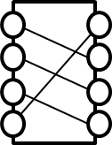
Rack Interconnect
S1
S2
Sk
…
1
2
3
4
5
6
7
8
Typical rack internconnect: ToR-Matching-ToR (TMT) model
17

Slide 42
Details: Switch Types Periodic Switch (aka Rotor Switch)
Rotor switch: periodic matchings (demand-oblivious)
M1
M2
M3
M1
M2
M3
Si:
time
18

Slide 43
Details: Switch Types Demand-Aware Switch
Demand-aware switch: optimized matchings
M1
M1
M3
M2
M2
M1
Si:
time
19

Slide 44
Details: Switch Types Static Switch
Static switches: combine for optimized static topology
M1
M2
M3
S1:
S2:
S3:
e.g, tree, expander
20

Slide 45
Design Tradeoffs (1) The “Awareness-Dimension”
Rotor
Demand-Aware
Demand- oblivious
Demand- aware
Good for all-to-all traffic!
⇀ oblivious: very fast
periodic direct connectivity
⇀ no control plane overhead
Good for elephant flows!
⇀ optimizable toward traffic
⇀ but slower
21

Slide 46
Design Tradeoffs (1) The “Awareness-Dimension”
low tax
Demand-Aware
high tax
Rotor
Demand- oblivious
Demand- aware
Good for all-to-all traffic!
⇀ oblivious: very fast
periodic direct connectivity
⇀ no control plane overhead
Good for elephant flows!
⇀ optimizable toward traffic
⇀ but slower
Compared to static networks: latency tax!
21

Slide 47
Design Tradeoffs (2) The “Flexibility-Dimension”
Dynamic
Good for high throughput!
⇀ direct connectivity saves
bandwidth along links
Rotor /
Demand-Aware
Good for low latency!
⇀ no need to wait for
reconfigurable links
⇀ compared to dynamic:
bandwidth tax (multi-hop)
Clos
Static
22

Slide 48
Design Tradeoffs (2) The “Flexibility-Dimension”
Dynamic
Good for high throughput!
⇀ direct connectivity saves
bandwidth along links
latency
tax
Rotor /
Demand-Aware
Good for low latency!
⇀ no need to wait for
reconfigurable links
⇀ compared to dynamic:
bandwidth tax (multi-hop)
bandwidth
tax
Clos
Static
22

Slide 49
First Observations
⇢ Observation 1: Different topologies provide
different tradeoffs.
⇢ Observation 2: Different traffic requires different
topology types.
⇢ Observation 3: A mismatch of demand and topology
can increase flow completion times.
⇀ bad idea: serving mice flows on Rotor topology
⇀ bad idea: serving elephant flows on static topology
23

Slide 50
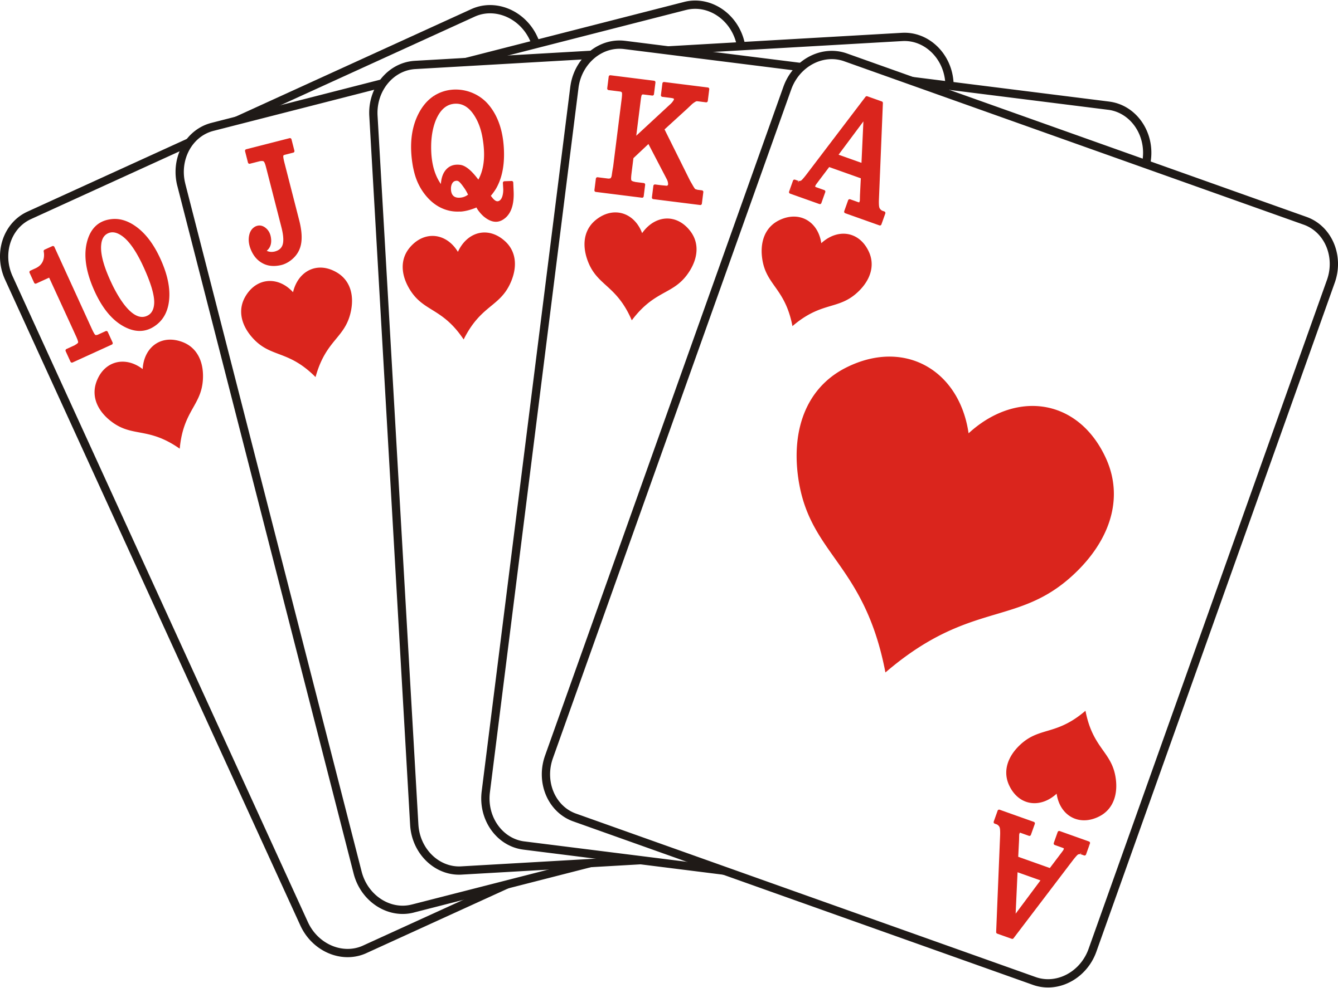

Examples:
Match or Mismatch?
Shuffling
ML
Dynamic
Delay sensitive
Telemetry / control
Rotor
Demand-Aware
Demand- oblivious
Demand- aware
Demand
Static
Static
Topology
24

Slide 51
Examples:
Match or Mismatch?
Shuffling
ML
Dynamic
?
Rotor
Demand-Aware
Delay sensitive
Telemetry / control
Demand- oblivious
Demand- aware
Demand
Static
Serving mice flows on demand-aware?
Static
Topology
24

Slide 52
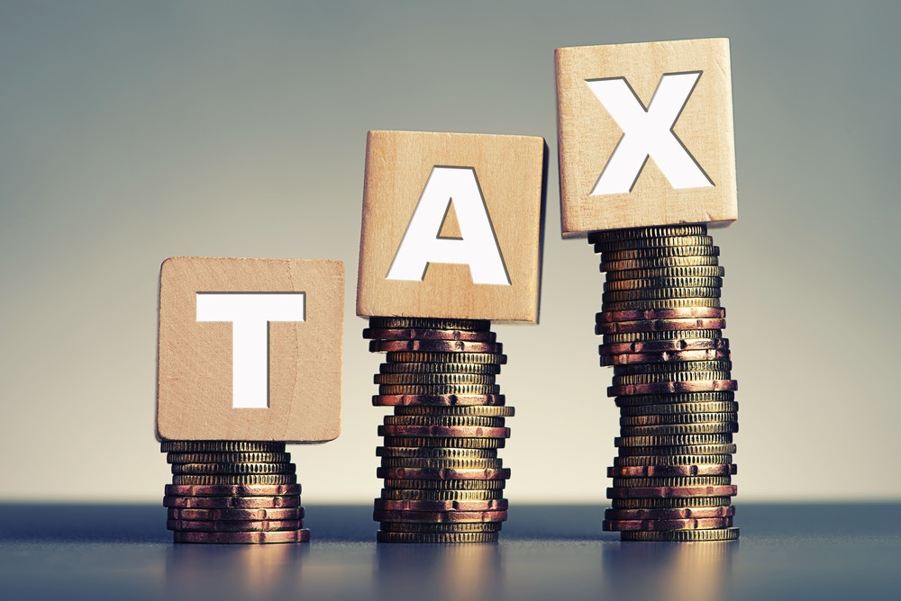
Examples:
Match or Mismatch?
Shuffling
ML
Dynamic
?
Rotor
Demand-Aware
Delay sensitive
Telemetry / control
Demand- oblivious
Demand- aware
Demand
Static
Serving mice flows on demand-aware?
Bad idea! Latency tax.
Static
Topology
24

Slide 53
Examples:
Match or Mismatch?
Shuffling
ML
Dynamic
?
Rotor
Demand-Aware
Delay sensitive
Telemetry / control
Demand- oblivious
Demand- aware
Demand
Static
Serving elephant flows on static?
Static
Topology
24

Slide 54
Examples:
Match or Mismatch?
Shuffling
ML
Dynamic
?
Rotor
Demand-Aware
Delay sensitive
Telemetry / control
Demand- oblivious
Demand- aware
Demand
Static
Serving elephant flows on static? Bad idea! Bandwidth tax.
Static
Topology
24

Slide 55

Cerberus:
Dynamic
Shuffling
ML
Demand- oblivious
Demand- aware
Delay sensitive
Telemetry / control
Static
Our system Cerberus* serves traffic on the “best topology”!
* Griner et al., ACM SIGMETRICS 2022

Slide 56
Flow Size Matters
⇢ Observation 1: Different apps have different flow size distributions.
⇢ Observation 2: The transmission time of a flow depends on its size.
⇢ Observation 3: For small flows, flow completion time suffers if
network needs to be reconfigured first.
⇢ Observation 4: For large flows, reconfiguration time may amortize.
25

Slide 57
Flow Size Matters
⇢ Observation 1: Different apps have different flow size distributions.
⇢ Observation 2: The transmission time of a flow depends on its size.
⇢ Observation 3: For small flows, flow completion time suffers if
network needs to be reconfigured first.
⇢ Observation 4: For large flows, reconfiguration time may amortize.
25

Slide 58
Flow Size Matters
⇢ Observation 1: Different apps have different flow size distributions.
⇢ Observation 2: The transmission time of a flow depends on its size.
⇢ Observation 3: For small flows, flow completion time suffers if
network needs to be reconfigured first.
⇢ Observation 4: For large flows, reconfiguration time may amortize.
25

Slide 59
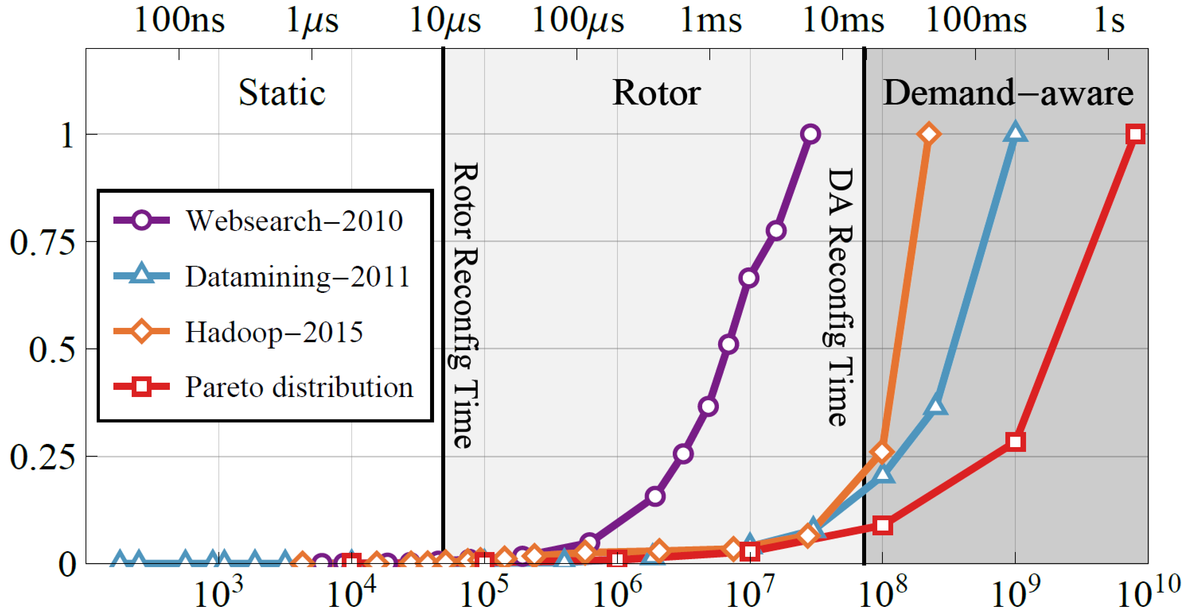
Flow Size Matters
⇢ Observation 1: Different apps have different flow size distributions.
⇢ Observation 2: The transmission time of a flow depends on its size.
⇢ Observation 3: For small flows, flow completion time suffers if
network needs to be reconfigured first.
⇢ Observation 4: For large flows, reconfiguration time may amortize.
25

Slide 60
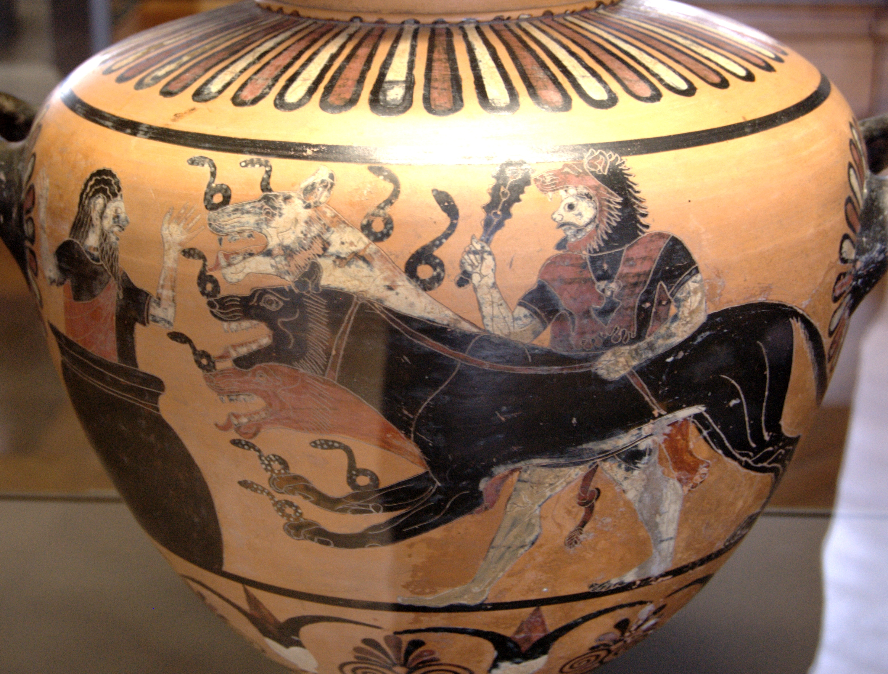
Cerberus
Optical Switches
1
2
3
4
5
6
7
8
26

Slide 61
Cerberus
K_{s}
static
switches
K_{r}
rotor
switches
K_{d}
demand-aware
switches
1
2
3
4
5
6
7
8
26

Slide 62

Cerberus
K_{s}
static
switches
K_{r}
rotor
switches
K_{d}
demand-aware
switches
1
2
3
4
5
6
7
8
Scheduling: Small flows go via static switches…
26

Slide 63
Cerberus
K_{s}
static
switches
K_{r}
rotor
switches
K_{d}
demand-aware
switches
1
2
3
4
5
6
7
8
Scheduling: … medium flows via rotor switches…
26

Slide 64
Cerberus
K_{s}
static
switches
K_{r}
rotor
switches
K_{d}
demand-aware
switches
1
2
3
4
5
6
7
8
Scheduling: … and large flows via demand-aware switches
(if one available, otherwise via rotor).
26

Slide 65

Throughput Analysis
Demand Matrix
$$T$$
Metric: throughput of a demand matrix…
27

Slide 66

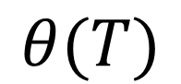
Throughput Analysis
Demand Matrix
$$T$$
$$×$$
$$θ(T)$$
… is the maximal scale down factor by which traffic is feasible.
Metric: throughput of a demand matrix…
27

Slide 67
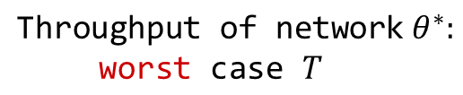
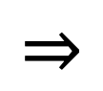
Throughput Analysis
Demand Matrix
$$T$$
$$×$$
$$θ(T)$$
$$⇒$$
… is the maximal scale down factor by which traffic is feasible.
Metric: throughput of a demand matrix…
$${\text{Throughput} \text{of} \text{network} θ}^{∗}:$$
$$\text{worst} \text{cas}\text{e} T$$
27

Slide 68
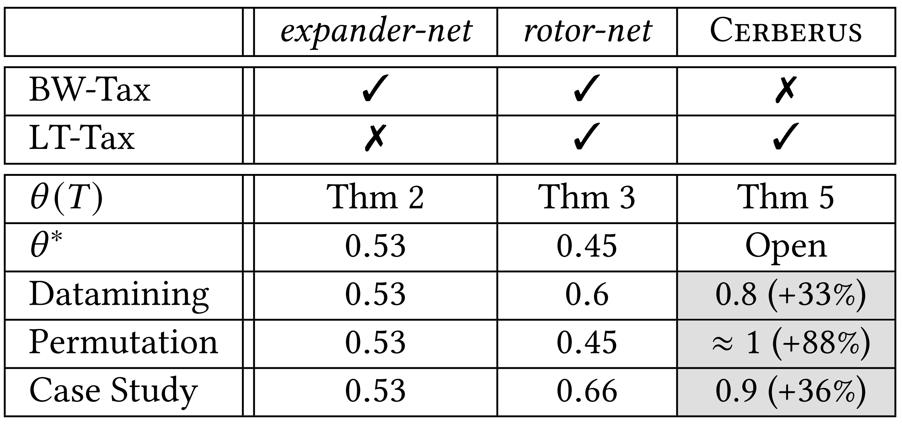
Throughput Analysis
Demand Matrix
$$T$$
$$×$$
$$θ(T)$$
$$⇒$$
Worst demand matrix for static and rotor: permutation. Best case for demand-aware!
BW tax!
BW & latency tax!
27
Notes:
throughput = theta factor we multiply demand => scale it down so we can send it over topology: throughput of a matrix on a given topology. for each demand we have a factor.
matrix is saturated
permutation matrix: is worst case for expander (pay much bandwidth tax), also worst for RotorNet
for demandaware it is the best
this is the worst case but what about real traffic?
depends on specific parameter of datamining
note

Slide 69
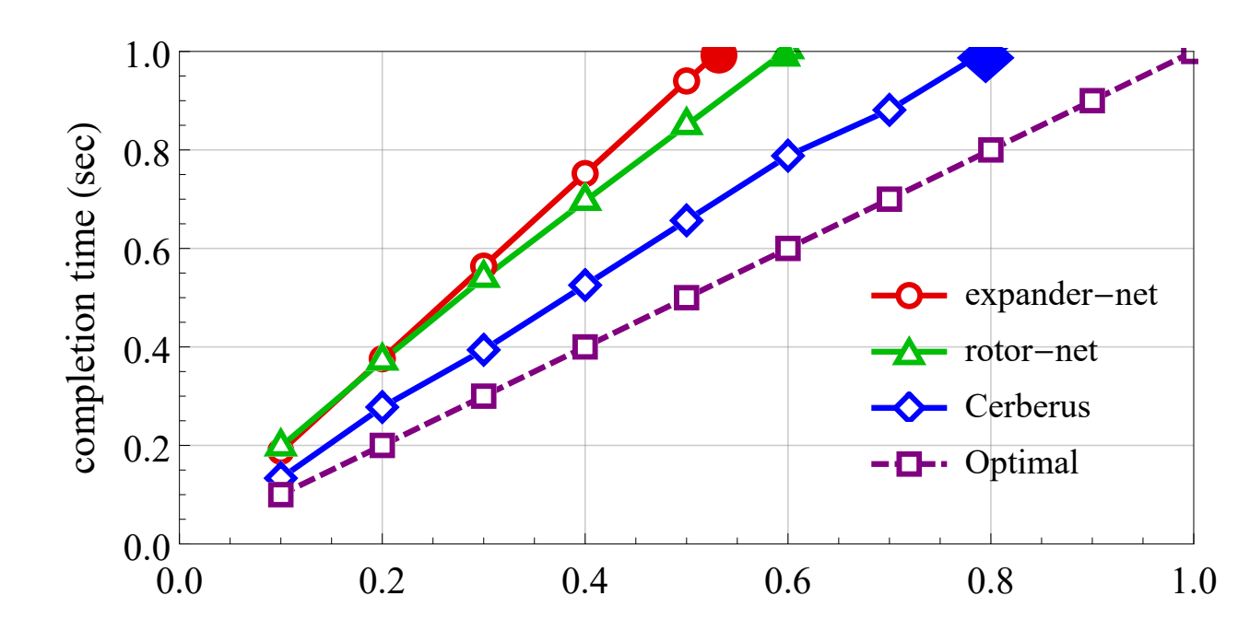
Completion Time
⇢ Demand completion time: How long does
it take to serve a demand matrix?
Data mining workload
⇢ Also useful in analysis: throughput can be computed more
easily via demand completion time.
28
Notes:
What about the methodology of finding throughput via demand completion time? When we know demand-completion time we can bound the throughput. Simpler to compute completion time, because can account for watiting time / tax easier,

Slide 70

Conclusion
⇢ Diverse traffic requires
diverse technologies
⇢ Cerberus aims to assign
traffic to its best topology
⇀ Depending on flow size
⇢ Many challenges
⇀ Impact on routing and congestion control
⇀ Sensitivity analysis
⇀ Prototyping
Thank you!
29

Slide 71

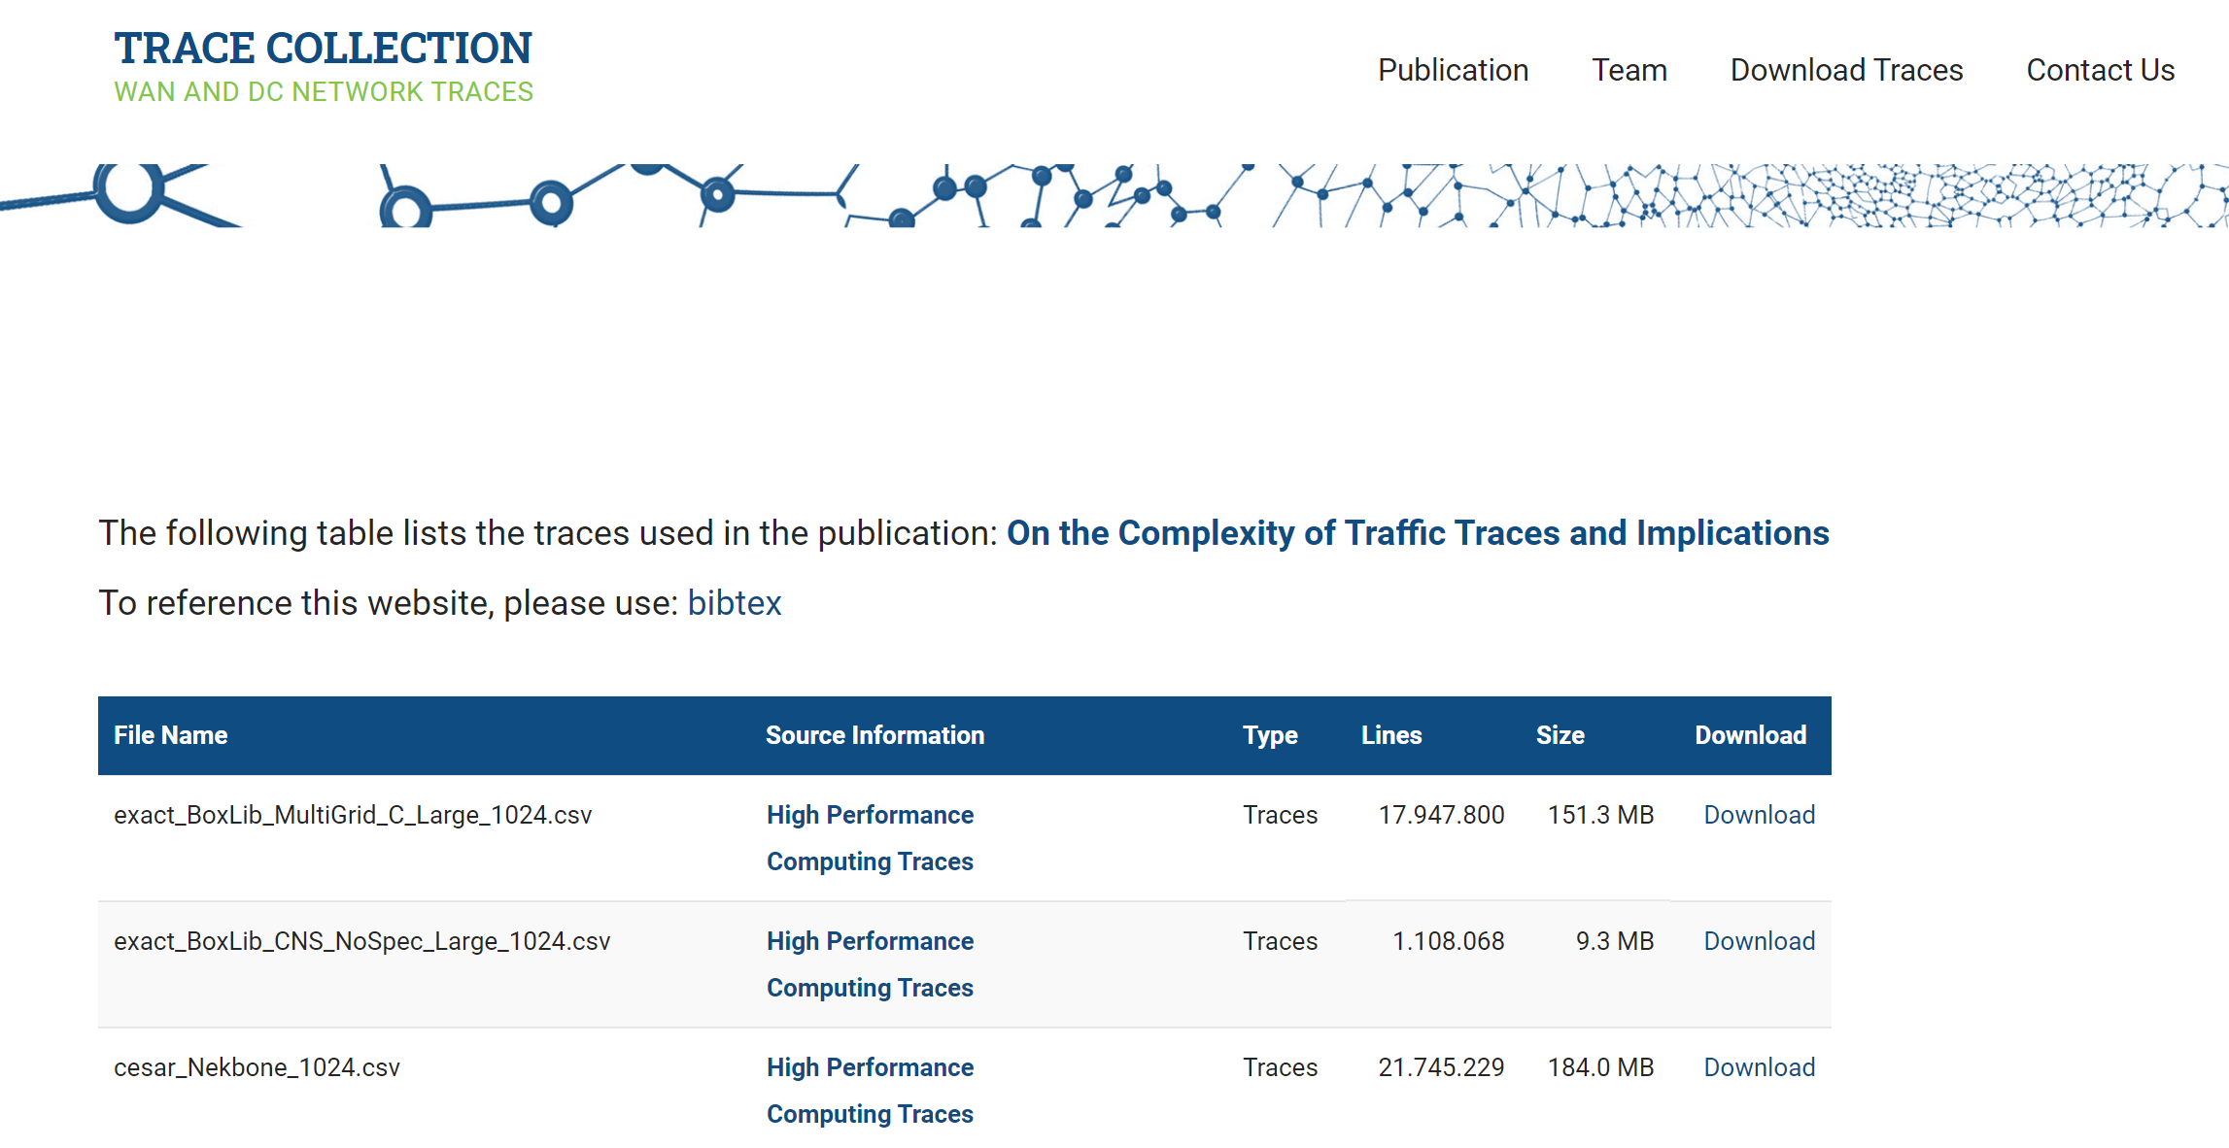
Websites
https://trace-collection.net/
Trace collection website
http://self-adjusting.net/
Project website
Notes:
Over the last years, we have worked on flexible routing (enabled by SDN) and flexible resource allocation and service embedding (enabled by virtualization).
With this project, we want to tackle the physical layer, enabled by emerging optical technologies.

Slide 72
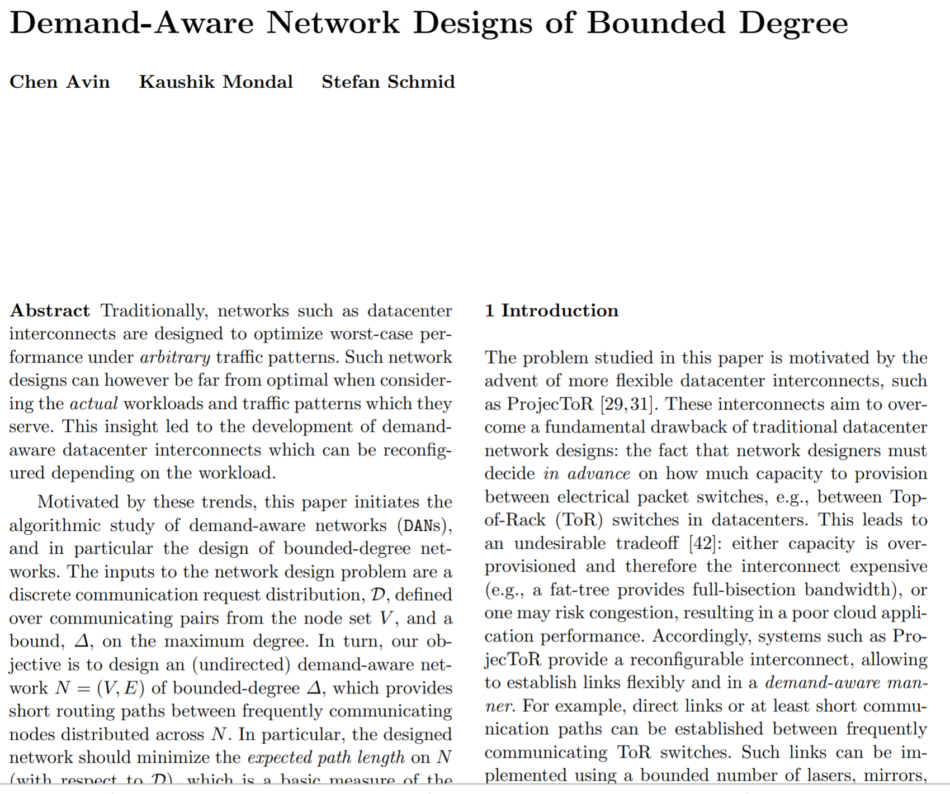
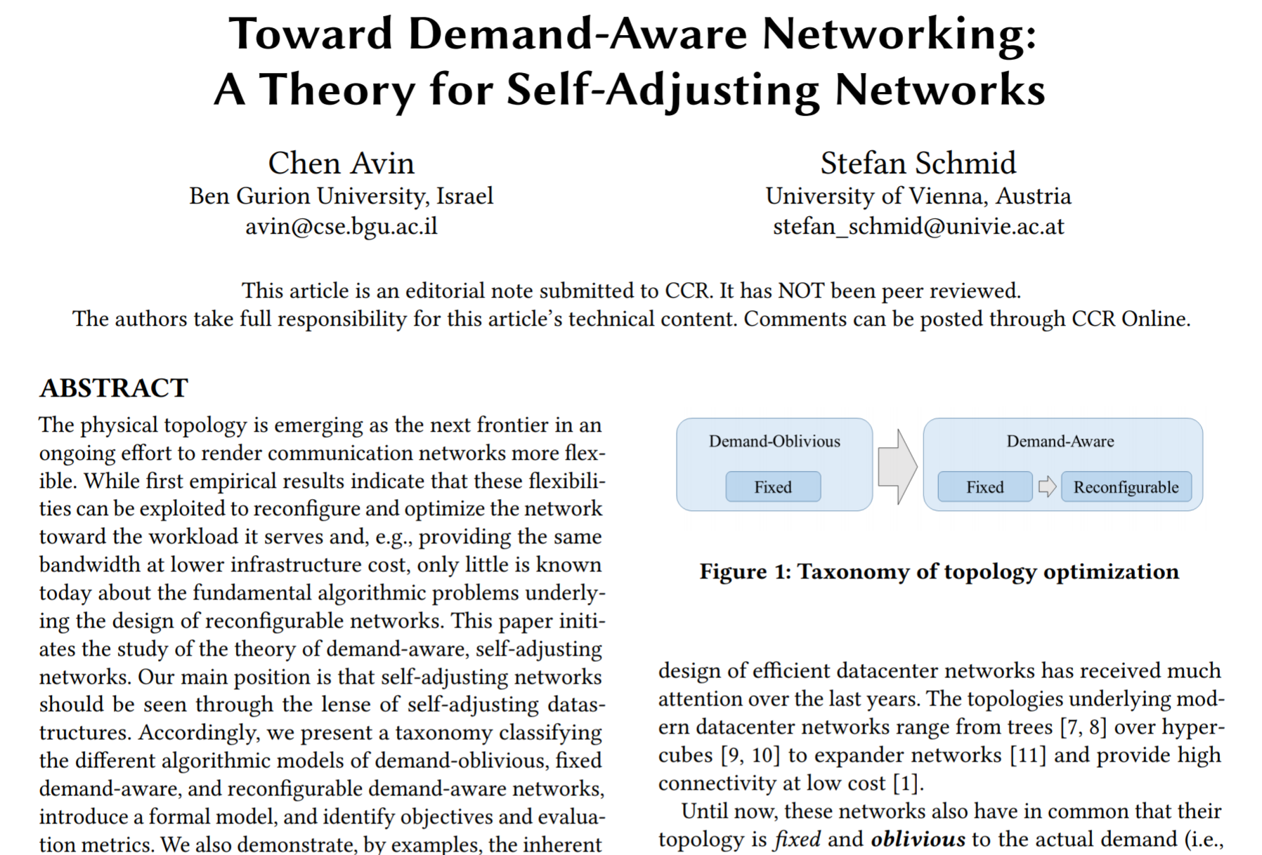
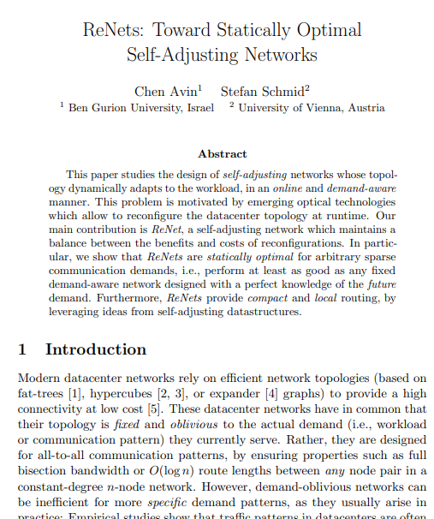
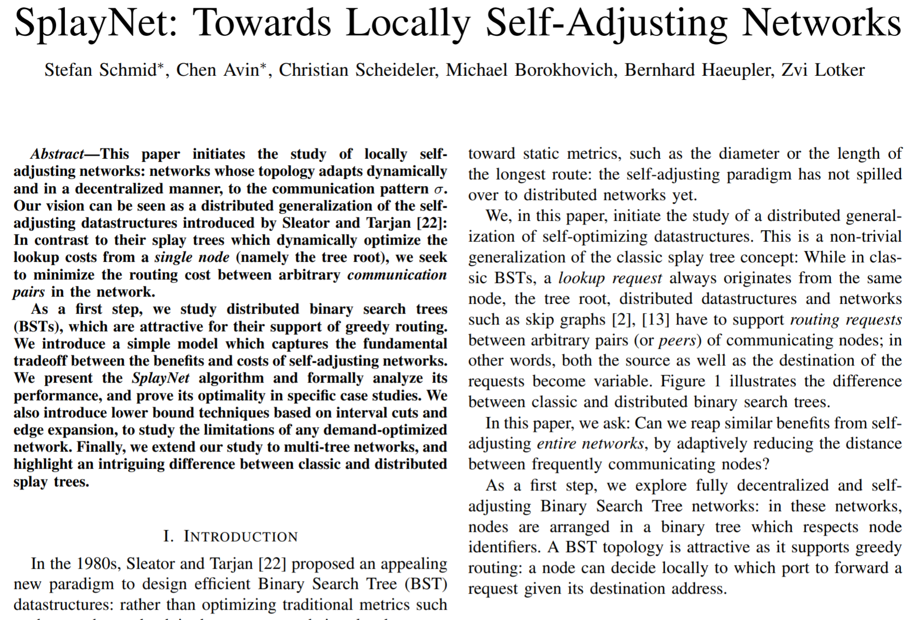
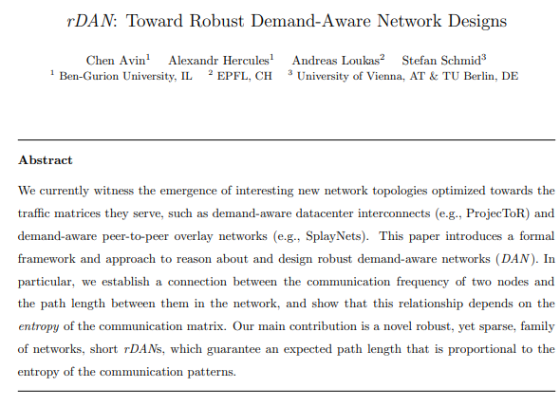
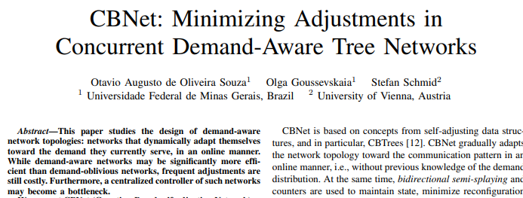
Further Reading
Static DAN
Overview: Models
Static Optimality
Robust DAN
Dynamic DAN
Concurrent DANs
Notes:
The potential gain can be significant.

Slide 73
Selected References
On the Complexity of Traffic Traces and Implications
Chen Avin, Manya Ghobadi, Chen Griner, and Stefan Schmid.
ACM SIGMETRICS, Boston, Massachusetts, USA, June 2020.
Survey of Reconfigurable Data Center Networks: Enablers, Algorithms, Complexity Klaus-Tycho Foerster and Stefan Schmid. SIGACT News, June 2019.
Toward Demand-Aware Networking: A Theory for Self-Adjusting Networks (Editorial) Chen Avin and Stefan Schmid. ACM SIGCOMM Computer Communication Review (CCR), October 2018.
Dynamically Optimal Self-Adjusting Single-Source Tree Networks Chen Avin, Kaushik Mondal, and Stefan Schmid.
14th Latin American Theoretical Informatics Symposium (LATIN), University of Sao Paulo, Sao Paulo, Brazil, May 2020.
Demand-Aware Network Design with Minimal Congestion and Route Lengths Chen Avin, Kaushik Mondal, and Stefan Schmid. 38th IEEE Conference on Computer Communications (INFOCOM), Paris, France, April 2019. Distributed Self-Adjusting Tree Networks Bruna Peres, Otavio Augusto de Oliveira Souza, Olga Goussevskaia, Chen Avin, and Stefan Schmid. 38th IEEE Conference on Computer Communications (INFOCOM), Paris, France, April 2019.
Efficient Non-Segregated Routing for Reconfigurable Demand-Aware Networks Thomas Fenz, Klaus-Tycho Foerster, Stefan Schmid, and Anaïs Villedieu. IFIP Networking, Warsaw, Poland, May 2019.
DaRTree: Deadline-Aware Multicast Transfers in Reconfigurable Wide-Area Networks Long Luo, Klaus-Tycho Foerster, Stefan Schmid, and Hongfang Yu. IEEE/ACM International Symposium on Quality of Service (IWQoS), Phoenix, Arizona, USA, June 2019.
Demand-Aware Network Designs of Bounded Degree Chen Avin, Kaushik Mondal, and Stefan Schmid. 31st International Symposium on Distributed Computing (DISC), Vienna, Austria, October 2017.
SplayNet: Towards Locally Self-Adjusting Networks Stefan Schmid, Chen Avin, Christian Scheideler, Michael Borokhovich, Bernhard Haeupler, and Zvi Lotker. IEEE/ACM Transactions on Networking (TON), Volume 24, Issue 3, 2016. Early version: IEEE IPDPS 2013.
Characterizing the Algorithmic Complexity of Reconfigurable Data Center Architectures Klaus-Tycho Foerster, Monia Ghobadi, and Stefan Schmid. ACM/IEEE Symposium on Architectures for Networking and Communications Systems (ANCS), Ithaca, New York, USA, July 2018.
Notes:
Over the last years, we have worked on flexible routing (enabled by SDN) and flexible resource allocation and service embedding (enabled by virtualization).
With this project, we want to tackle the physical layer, enabled by emerging optical technologies.

Slide 74

Bonus Material
Hogwarts Stair
Notes:
Over the last years, we have worked on flexible routing (enabled by SDN) and flexible resource allocation and service embedding (enabled by virtualization).
With this project, we want to tackle the physical layer, enabled by emerging optical technologies.

Slide 75

Bonus Material
Golden Gate Zipper
Notes:
Over the last years, we have worked on flexible routing (enabled by SDN) and flexible resource allocation and service embedding (enabled by virtualization).
With this project, we want to tackle the physical layer, enabled by emerging optical technologies.

Slide 76

Bonus Material
In HPC
Notes:
Over the last years, we have worked on flexible routing (enabled by SDN) and flexible resource allocation and service embedding (enabled by virtualization).
With this project, we want to tackle the physical layer, enabled by emerging optical technologies.

Slide 77
Question:
How to Quantify such “Structure” in the Demand?
Notes:
Let me give you an idea of the questions and approach used in our project.
A first most basic question regards how we can quantify the structure in the demand.

Slide 78


Intuition Which demand has more structure?
⇢ Traffic matrices of two different distributed ML applications
⇀ GPU-to-GPU
Color = communication pair
vs
vs
Notes:
We believe that an information-theoretic approach can provide interesting insights here.
As a first approach, we have used iterative randomization and compression to identify the different dimensions of structure.
The resulting complexity map looks like this: On the x-axis, there is the temporal complexity, on the y-axis the non-temporal. Workloads without any structure end up on the upper right.

Slide 79
Intuition Which demand has more structure?
⇢ Traffic matrices of two different distributed ML applications
⇀ GPU-to-GPU
Color = communication pair
vs
vs
More uniform
More structure
Notes:
We believe that an information-theoretic approach can provide interesting insights here.
As a first approach, we have used iterative randomization and compression to identify the different dimensions of structure.
The resulting complexity map looks like this: On the x-axis, there is the temporal complexity, on the y-axis the non-temporal. Workloads without any structure end up on the upper right.

Slide 80


Intuition Spatial vs temporal structure
⇢ Two different ways to generate same traffic matrix:
⇀ Same non-temporal structure
⇢ Which one has more structure?
vs
vs
Notes:
We believe that an information-theoretic approach can provide interesting insights here.
As a first approach, we have used iterative randomization and compression to identify the different dimensions of structure.
The resulting complexity map looks like this: On the x-axis, there is the temporal complexity, on the y-axis the non-temporal. Workloads without any structure end up on the upper right.

Slide 81
Intuition Spatial vs temporal structure
⇢ Two different ways to generate same traffic matrix:
⇀ Same non-temporal structure
⇢ Which one has more structure?
vs
vs
Systematically?
Notes:
We believe that an information-theoretic approach can provide interesting insights here.
As a first approach, we have used iterative randomization and compression to identify the different dimensions of structure.
The resulting complexity map looks like this: On the x-axis, there is the temporal complexity, on the y-axis the non-temporal. Workloads without any structure end up on the upper right.

Slide 82

Trace Complexity Information-Theoretic Approach
“Shuffle&Compress”
Original
Time
Notes:
We believe that an information-theoretic approach can provide interesting insights here.
As a first approach, we have used iterative randomization and compression to identify the different dimensions of structure.
The resulting complexity map looks like this: On the x-axis, there is the temporal complexity, on the y-axis the non-temporal. Workloads without any structure end up on the upper right.

Slide 83



Trace Complexity Information-Theoretic Approach
“Shuffle&Compress”
Original
Randomize rows
Uniform
Increasing complexity (systematically randomized)
More structure (compresses better)
Notes:
We believe that an information-theoretic approach can provide interesting insights here.
As a first approach, we have used iterative randomization and compression to identify the different dimensions of structure.
The resulting complexity map looks like this: On the x-axis, there is the temporal complexity, on the y-axis the non-temporal. Workloads without any structure end up on the upper right.

Slide 84
Trace Complexity Information-Theoretic Approach
“Shuffle&Compress”
Original
Randomize rows
Uniform
Remove temporal
Remove non-temp.
Notes:
We believe that an information-theoretic approach can provide interesting insights here.
As a first approach, we have used iterative randomization and compression to identify the different dimensions of structure.
The resulting complexity map looks like this: On the x-axis, there is the temporal complexity, on the y-axis the non-temporal. Workloads without any structure end up on the upper right.

Slide 85
Trace Complexity Information-Theoretic Approach
“Shuffle&Compress”
Original
Randomize rows
Uniform
Shuffle
Remove temporal
Remove non-temp.
Compress
Difference in size (entropy)?
Difference in size (entropy)?
Notes:
We believe that an information-theoretic approach can provide interesting insights here.
As a first approach, we have used iterative randomization and compression to identify the different dimensions of structure.
The resulting complexity map looks like this: On the x-axis, there is the temporal complexity, on the y-axis the non-temporal. Workloads without any structure end up on the upper right.

Slide 86
Trace Complexity Information-Theoretic Approach
“Shuffle&Compress”
Original
Randomize rows
Uniform
Shuffle
Remove temporal
Remove non-temp.
Can be used to define 2-dimensional complexity map!
Compress
Difference in size (entropy)?
Difference in size (entropy)?
Notes:
We believe that an information-theoretic approach can provide interesting insights here.
As a first approach, we have used iterative randomization and compression to identify the different dimensions of structure.
The resulting complexity map looks like this: On the x-axis, there is the temporal complexity, on the y-axis the non-temporal. Workloads without any structure end up on the upper right.

Slide 87

Our Methodology Complexity Map
bursty
uniform
No structure
Our approach: iterative randomization and compression of trace to identify dimensions of structure.
non-temporal complexity
bursty & skewed
skewed
temporal complexity
Notes:
We believe that an information-theoretic approach can provide interesting insights here.
As a first approach, we have used iterative randomization and compression to identify the different dimensions of structure.
The resulting complexity map looks like this: On the x-axis, there is the temporal complexity, on the y-axis the non-temporal. Workloads without any structure end up on the upper right.

Slide 88
Our Methodology Complexity Map
bursty
uniform
No structure
pF
CNS
ML
DB
Our approach: iterative randomization and compression of trace to identify dimensions of structure.
Web
non-temporal complexity
Multi
Grid
Had
NN
bursty & skewed
Different structures!
skewed
temporal complexity
Notes:
When mapping different applications, we can see that they end up at different locations: they have different amounts of temporal and non-temporal structures.

Slide 89
Our Methodology Complexity Map
bursty
uniform
pF
CNS
ML
DB
Our approach: iterative randomization and compression of trace to identify dimensions of structure.
Potential gain!
Web
non-temporal complexity
Multi
Grid
Had
NN
bursty & skewed
Different structures!
skewed
temporal complexity
Notes:
The potential gain can be significant.

Slide 90

Further Reading ACM SIGMETRICS 2020
Notes:
The potential gain can be significant.

Slide 91



Case Study “Route Lengths” Constant-Degree Demand-Aware Network
Destinations
1
2
3
4
5
6
7
7
1
0 | $$\frac{2}{65}$$ | $$\frac{1}{13}$$ | $$\frac{1}{65}$$ | $$\frac{1}{65}$$ | $$\frac{2}{65}$$ | $$\frac{3}{65}$$
$$\frac{2}{65}$$ | 0 | $$\frac{1}{65}$$ | 0 | 0 | 0 | $$\frac{2}{65}$$
$$\frac{1}{13}$$ | $$\frac{1}{65}$$ | 0 | $$\frac{2}{65}$$ | 0 | 0 | $$\frac{1}{13}$$
$$\frac{1}{65}$$ | 0 | $$\frac{2}{65}$$ | 0 | $$\frac{4}{65}$$ | 0 | 0
$$\frac{1}{65}$$ | 0 | $$\frac{3}{65}$$ | $$\frac{4}{65}$$ | 0 | 0 | 0
$$\frac{2}{65}$$ | 0 | 0 | 0 | 0 | 0 | $$\frac{3}{65}$$
$$\frac{3}{65}$$ | $$\frac{2}{65}$$ | $$\frac{1}{13}$$ | 0 | 0 | $$\frac{3}{65}$$ | 0
2
1
6
3
Sources
4
5
2
5
6
7
3
4
$$=\sum_{(u,v)∈\text{D}}{p\left(u,v\right)∙dN(u,v)}$$
$$ERL\left(\text{D}\text{,}\text{N}\right)$$
Notes:
So far, we have just scratched the surface, and with this ERC project, we want to explore the rest of the iceberg.
Indeed, the notion of self-adjusting networks opens are large uncharted field, with many questions.
We structure our project around models and metrics, algorithms, fault-tolerance, integration into higher layers, and case studies.
In particular, we will explore metrics and algorithms for by how much load can be lowered, energy reduced and quality-of-service improved in selfadjusting networks.
We also need to develop models for the tradeoff between the benefits and costs of reconfigurations over time.
We also study how self-adjusting networks can be used to improve fault-tolerance, what is the impact on other layers, and how to apply our solutions in a specific case study, e.g., how to develop a scalable control plane.
This project hence requires expertises from different fields, from networking, over distributed systems, algorithms, to performance evaluation.
I have the necessary background in all these areas.

Slide 92
Case Study “Route Lengths” Constant-Degree Demand-Aware Network
Destinations
1
2
3
4
5
6
7
7
1
0 | $$\frac{2}{65}$$ | $$\frac{1}{13}$$ | $$\frac{1}{65}$$ | $$\frac{1}{65}$$ | $$\frac{2}{65}$$ | $$\frac{3}{65}$$
$$\frac{2}{65}$$ | 0 | $$\frac{1}{65}$$ | 0 | 0 | 0 | $$\frac{2}{65}$$
$$\frac{1}{13}$$ | $$\frac{1}{65}$$ | 0 | $$\frac{2}{65}$$ | 0 | 0 | $$\frac{1}{13}$$
$$\frac{1}{65}$$ | 0 | $$\frac{2}{65}$$ | 0 | $$\frac{4}{65}$$ | 0 | 0
$$\frac{1}{65}$$ | 0 | $$\frac{3}{65}$$ | $$\frac{4}{65}$$ | 0 | 0 | 0
$$\frac{2}{65}$$ | 0 | 0 | 0 | 0 | 0 | $$\frac{3}{65}$$
$$\frac{3}{65}$$ | $$\frac{2}{65}$$ | $$\frac{1}{13}$$ | 0 | 0 | $$\frac{3}{65}$$ | 0
2
1
6
3
Sources
4
5
2
5
6
Much from 4 to 5
7
Add link
3
4
$$=\sum_{(u,v)∈\text{D}}{p\left(u,v\right)∙dN(u,v)}$$
$$ERL\left(\text{D}\text{,}\text{N}\right)$$
Notes:
So far, we have just scratched the surface, and with this ERC project, we want to explore the rest of the iceberg.
Indeed, the notion of self-adjusting networks opens are large uncharted field, with many questions.
We structure our project around models and metrics, algorithms, fault-tolerance, integration into higher layers, and case studies.
In particular, we will explore metrics and algorithms for by how much load can be lowered, energy reduced and quality-of-service improved in selfadjusting networks.
We also need to develop models for the tradeoff between the benefits and costs of reconfigurations over time.
We also study how self-adjusting networks can be used to improve fault-tolerance, what is the impact on other layers, and how to apply our solutions in a specific case study, e.g., how to develop a scalable control plane.
This project hence requires expertises from different fields, from networking, over distributed systems, algorithms, to performance evaluation.
I have the necessary background in all these areas.

Slide 93
Case Study “Route Lengths” Constant-Degree Demand-Aware Network
Communicated with many
Destinations
1
2
3
4
5
6
7
7
1
0 | $$\frac{2}{65}$$ | $$\frac{1}{13}$$ | $$\frac{1}{65}$$ | $$\frac{1}{65}$$ | $$\frac{2}{65}$$ | $$\frac{3}{65}$$
$$\frac{2}{65}$$ | 0 | $$\frac{1}{65}$$ | 0 | 0 | 0 | $$\frac{2}{65}$$
$$\frac{1}{13}$$ | $$\frac{1}{65}$$ | 0 | $$\frac{2}{65}$$ | 0 | 0 | $$\frac{1}{13}$$
$$\frac{1}{65}$$ | 0 | $$\frac{2}{65}$$ | 0 | $$\frac{4}{65}$$ | 0 | 0
$$\frac{1}{65}$$ | 0 | $$\frac{3}{65}$$ | $$\frac{4}{65}$$ | 0 | 0 | 0
$$\frac{2}{65}$$ | 0 | 0 | 0 | 0 | 0 | $$\frac{3}{65}$$
$$\frac{3}{65}$$ | $$\frac{2}{65}$$ | $$\frac{1}{13}$$ | 0 | 0 | $$\frac{3}{65}$$ | 0
2
1
6
3
indirect
Sources
4
5
2
5
6
7
3
4
$$=\sum_{(u,v)∈\text{D}}{p\left(u,v\right)∙dN(u,v)}$$
$$ERL\left(\text{D}\text{,}\text{N}\right)$$
Notes:
So far, we have just scratched the surface, and with this ERC project, we want to explore the rest of the iceberg.
Indeed, the notion of self-adjusting networks opens are large uncharted field, with many questions.
We structure our project around models and metrics, algorithms, fault-tolerance, integration into higher layers, and case studies.
In particular, we will explore metrics and algorithms for by how much load can be lowered, energy reduced and quality-of-service improved in selfadjusting networks.
We also need to develop models for the tradeoff between the benefits and costs of reconfigurations over time.
We also study how self-adjusting networks can be used to improve fault-tolerance, what is the impact on other layers, and how to apply our solutions in a specific case study, e.g., how to develop a scalable control plane.
This project hence requires expertises from different fields, from networking, over distributed systems, algorithms, to performance evaluation.
I have the necessary background in all these areas.

Slide 94
Case Study “Route Lengths” Constant-Degree Demand-Aware Network
Destinations
1
2
3
4
5
6
7
7
1
0 | $$\frac{2}{65}$$ | $$\frac{1}{13}$$ | $$\frac{1}{65}$$ | $$\frac{1}{65}$$ | $$\frac{2}{65}$$ | $$\frac{3}{65}$$
$$\frac{2}{65}$$ | 0 | $$\frac{1}{65}$$ | 0 | 0 | 0 | $$\frac{2}{65}$$
$$\frac{1}{13}$$ | $$\frac{1}{65}$$ | 0 | $$\frac{2}{65}$$ | 0 | 0 | $$\frac{1}{13}$$
$$\frac{1}{65}$$ | 0 | $$\frac{2}{65}$$ | 0 | $$\frac{4}{65}$$ | 0 | 0
$$\frac{1}{65}$$ | 0 | $$\frac{3}{65}$$ | $$\frac{4}{65}$$ | 0 | 0 | 0
$$\frac{2}{65}$$ | 0 | 0 | 0 | 0 | 0 | $$\frac{3}{65}$$
$$\frac{3}{65}$$ | $$\frac{2}{65}$$ | $$\frac{1}{13}$$ | 0 | 0 | $$\frac{3}{65}$$ | 0
2
1
6
Don’t
communicate
3
Makes sense
Sources
4
5
2
5
6
7
3
4
$$=\sum_{(u,v)∈\text{D}}{p\left(u,v\right)∙dN(u,v)}$$
$$ERL\left(\text{D}\text{,}\text{N}\right)$$
Notes:
So far, we have just scratched the surface, and with this ERC project, we want to explore the rest of the iceberg.
Indeed, the notion of self-adjusting networks opens are large uncharted field, with many questions.
We structure our project around models and metrics, algorithms, fault-tolerance, integration into higher layers, and case studies.
In particular, we will explore metrics and algorithms for by how much load can be lowered, energy reduced and quality-of-service improved in selfadjusting networks.
We also need to develop models for the tradeoff between the benefits and costs of reconfigurations over time.
We also study how self-adjusting networks can be used to improve fault-tolerance, what is the impact on other layers, and how to apply our solutions in a specific case study, e.g., how to develop a scalable control plane.
This project hence requires expertises from different fields, from networking, over distributed systems, algorithms, to performance evaluation.
I have the necessary background in all these areas.

Slide 95
Algorithm: Idea
Destinations
1
2
3
4
5
6
7
1
0 | $$\frac{2}{65}$$ | $$\frac{1}{13}$$ | $$\frac{1}{65}$$ | $$\frac{1}{65}$$ | $$\frac{2}{65}$$ | $$\frac{3}{65}$$
$$\frac{2}{65}$$ | 0 | $$\frac{1}{65}$$ | 0 | 0 | 0 | $$\frac{2}{65}$$
$$\frac{1}{13}$$ | $$\frac{1}{65}$$ | 0 | $$\frac{2}{65}$$ | 0 | 0 | $$\frac{1}{13}$$
$$\frac{1}{65}$$ | 0 | $$\frac{2}{65}$$ | 0 | $$\frac{4}{65}$$ | 0 | 0
$$\frac{1}{65}$$ | 0 | $$\frac{3}{65}$$ | $$\frac{4}{65}$$ | 0 | 0 | 0
$$\frac{2}{65}$$ | 0 | 0 | 0 | 0 | 0 | $$\frac{3}{65}$$
$$\frac{3}{65}$$ | $$\frac{2}{65}$$ | $$\frac{1}{13}$$ | 0 | 0 | $$\frac{3}{65}$$ | 0
2
3
Sources
4
5
6
Huffman tree:
“ego-tree”
Notes:
So far, we have just scratched the surface, and with this ERC project, we want to explore the rest of the iceberg.
Indeed, the notion of self-adjusting networks opens are large uncharted field, with many questions.
We structure our project around models and metrics, algorithms, fault-tolerance, integration into higher layers, and case studies.
In particular, we will explore metrics and algorithms for by how much load can be lowered, energy reduced and quality-of-service improved in selfadjusting networks.
We also need to develop models for the tradeoff between the benefits and costs of reconfigurations over time.
We also study how self-adjusting networks can be used to improve fault-tolerance, what is the impact on other layers, and how to apply our solutions in a specific case study, e.g., how to develop a scalable control plane.
This project hence requires expertises from different fields, from networking, over distributed systems, algorithms, to performance evaluation.
I have the necessary background in all these areas.

Slide 96

Entropy Upper Bound
⇢ Idea for algorithm:
⇀ union of trees
⇀ reduce degree
⇀ but keep distances
Notes:
So far, we have just scratched the surface, and with this ERC project, we want to explore the rest of the iceberg.
Indeed, the notion of self-adjusting networks opens are large uncharted field, with many questions.
We structure our project around models and metrics, algorithms, fault-tolerance, integration into higher layers, and case studies.
In particular, we will explore metrics and algorithms for by how much load can be lowered, energy reduced and quality-of-service improved in selfadjusting networks.
We also need to develop models for the tradeoff between the benefits and costs of reconfigurations over time.
We also study how self-adjusting networks can be used to improve fault-tolerance, what is the impact on other layers, and how to apply our solutions in a specific case study, e.g., how to develop a scalable control plane.
This project hence requires expertises from different fields, from networking, over distributed systems, algorithms, to performance evaluation.
I have the necessary background in all these areas.

Slide 97
Entropy Upper Bound
⇢ Idea for algorithm:
⇀ union of trees
⇀ reduce degree
⇀ but keep distances
⇢ Ok for sparse demands
⇀ not everyone gets tree
⇀ helper nodes
Notes:
So far, we have just scratched the surface, and with this ERC project, we want to explore the rest of the iceberg.
Indeed, the notion of self-adjusting networks opens are large uncharted field, with many questions.
We structure our project around models and metrics, algorithms, fault-tolerance, integration into higher layers, and case studies.
In particular, we will explore metrics and algorithms for by how much load can be lowered, energy reduced and quality-of-service improved in selfadjusting networks.
We also need to develop models for the tradeoff between the benefits and costs of reconfigurations over time.
We also study how self-adjusting networks can be used to improve fault-tolerance, what is the impact on other layers, and how to apply our solutions in a specific case study, e.g., how to develop a scalable control plane.
This project hence requires expertises from different fields, from networking, over distributed systems, algorithms, to performance evaluation.
I have the necessary background in all these areas.

Slide 98
Entropy Upper Bound
⇢ Idea for algorithm:
⇀ union of trees
⇀ reduce degree
⇀ but keep distances
⇢ Ok for sparse demands
⇀ not everyone gets tree
⇀ helper nodes
Notes:
So far, we have just scratched the surface, and with this ERC project, we want to explore the rest of the iceberg.
Indeed, the notion of self-adjusting networks opens are large uncharted field, with many questions.
We structure our project around models and metrics, algorithms, fault-tolerance, integration into higher layers, and case studies.
In particular, we will explore metrics and algorithms for by how much load can be lowered, energy reduced and quality-of-service improved in selfadjusting networks.
We also need to develop models for the tradeoff between the benefits and costs of reconfigurations over time.
We also study how self-adjusting networks can be used to improve fault-tolerance, what is the impact on other layers, and how to apply our solutions in a specific case study, e.g., how to develop a scalable control plane.
This project hence requires expertises from different fields, from networking, over distributed systems, algorithms, to performance evaluation.
I have the necessary background in all these areas.

Slide 99
Entropy Upper Bound
⇢ Idea for algorithm:
⇀ union of trees
⇀ reduce degree
⇀ but keep distances
⇢ Ok for sparse demands
⇀ not everyone gets tree
⇀ helper nodes
Static
Notes:
So far, we have just scratched the surface, and with this ERC project, we want to explore the rest of the iceberg.
Indeed, the notion of self-adjusting networks opens are large uncharted field, with many questions.
We structure our project around models and metrics, algorithms, fault-tolerance, integration into higher layers, and case studies.
In particular, we will explore metrics and algorithms for by how much load can be lowered, energy reduced and quality-of-service improved in selfadjusting networks.
We also need to develop models for the tradeoff between the benefits and costs of reconfigurations over time.
We also study how self-adjusting networks can be used to improve fault-tolerance, what is the impact on other layers, and how to apply our solutions in a specific case study, e.g., how to develop a scalable control plane.
This project hence requires expertises from different fields, from networking, over distributed systems, algorithms, to performance evaluation.
I have the necessary background in all these areas.

Slide 100


Intuition of Algorithm
Demand graph:
Demand-aware network:
Ego-trees for large nodes
Helper node
Notes:
So far, we have just scratched the surface, and with this ERC project, we want to explore the rest of the iceberg.
Indeed, the notion of self-adjusting networks opens are large uncharted field, with many questions.
We structure our project around models and metrics, algorithms, fault-tolerance, integration into higher layers, and case studies.
In particular, we will explore metrics and algorithms for by how much load can be lowered, energy reduced and quality-of-service improved in selfadjusting networks.
We also need to develop models for the tradeoff between the benefits and costs of reconfigurations over time.
We also study how self-adjusting networks can be used to improve fault-tolerance, what is the impact on other layers, and how to apply our solutions in a specific case study, e.g., how to develop a scalable control plane.
This project hence requires expertises from different fields, from networking, over distributed systems, algorithms, to performance evaluation.
I have the necessary background in all these areas.

Slide 101

Entropy Lower Bound
destinations
sources
ERL=Ω(H$\text{Δ}$(Y|X))
degree
Notes:
So far, we have just scratched the surface, and with this ERC project, we want to explore the rest of the iceberg.
Indeed, the notion of self-adjusting networks opens are large uncharted field, with many questions.
We structure our project around models and metrics, algorithms, fault-tolerance, integration into higher layers, and case studies.
In particular, we will explore metrics and algorithms for by how much load can be lowered, energy reduced and quality-of-service improved in selfadjusting networks.
We also need to develop models for the tradeoff between the benefits and costs of reconfigurations over time.
We also study how self-adjusting networks can be used to improve fault-tolerance, what is the impact on other layers, and how to apply our solutions in a specific case study, e.g., how to develop a scalable control plane.
This project hence requires expertises from different fields, from networking, over distributed systems, algorithms, to performance evaluation.
I have the necessary background in all these areas.

Slide 102
Dynamic Algorithm
Dynamic
Notes:
So far, we have just scratched the surface, and with this ERC project, we want to explore the rest of the iceberg.
Indeed, the notion of self-adjusting networks opens are large uncharted field, with many questions.
We structure our project around models and metrics, algorithms, fault-tolerance, integration into higher layers, and case studies.
In particular, we will explore metrics and algorithms for by how much load can be lowered, energy reduced and quality-of-service improved in selfadjusting networks.
We also need to develop models for the tradeoff between the benefits and costs of reconfigurations over time.
We also study how self-adjusting networks can be used to improve fault-tolerance, what is the impact on other layers, and how to apply our solutions in a specific case study, e.g., how to develop a scalable control plane.
This project hence requires expertises from different fields, from networking, over distributed systems, algorithms, to performance evaluation.
I have the necessary background in all these areas.

Slide 103




Further Reading TON 2016, DISC 2017, CCR 2019, INFOCOM 2019
Notes:
The potential gain can be significant.

Slide 104
Related Problem Virtual Network Embedding Problem (VNEP)
Example △=2: A Minium Linear Arrangement (MLA) Problem
⇀ Minimizes sum of virtual
edges
Embedding?
Notes:
So far, we have just scratched the surface, and with this ERC project, we want to explore the rest of the iceberg.
Indeed, the notion of self-adjusting networks opens are large uncharted field, with many questions.
We structure our project around models and metrics, algorithms, fault-tolerance, integration into higher layers, and case studies.
In particular, we will explore metrics and algorithms for by how much load can be lowered, energy reduced and quality-of-service improved in selfadjusting networks.
We also need to develop models for the tradeoff between the benefits and costs of reconfigurations over time.
We also study how self-adjusting networks can be used to improve fault-tolerance, what is the impact on other layers, and how to apply our solutions in a specific case study, e.g., how to develop a scalable control plane.
This project hence requires expertises from different fields, from networking, over distributed systems, algorithms, to performance evaluation.
I have the necessary background in all these areas.

Slide 105
Related Problem Virtual Network Embedding Problem (VNEP)
Example △=2: A Minium Linear Arrangement (MLA) Problem
⇀ Minimizes sum of virtual
edges
cost 5
Bad!
Notes:
So far, we have just scratched the surface, and with this ERC project, we want to explore the rest of the iceberg.
Indeed, the notion of self-adjusting networks opens are large uncharted field, with many questions.
We structure our project around models and metrics, algorithms, fault-tolerance, integration into higher layers, and case studies.
In particular, we will explore metrics and algorithms for by how much load can be lowered, energy reduced and quality-of-service improved in selfadjusting networks.
We also need to develop models for the tradeoff between the benefits and costs of reconfigurations over time.
We also study how self-adjusting networks can be used to improve fault-tolerance, what is the impact on other layers, and how to apply our solutions in a specific case study, e.g., how to develop a scalable control plane.
This project hence requires expertises from different fields, from networking, over distributed systems, algorithms, to performance evaluation.
I have the necessary background in all these areas.

Slide 106
Related Problem Virtual Network Embedding Problem (VNEP)
Example △=2: A Minium Linear Arrangement (MLA) Problem
⇀ Minimizes sum of virtual
edges
cost 1
Good!
Notes:
So far, we have just scratched the surface, and with this ERC project, we want to explore the rest of the iceberg.
Indeed, the notion of self-adjusting networks opens are large uncharted field, with many questions.
We structure our project around models and metrics, algorithms, fault-tolerance, integration into higher layers, and case studies.
In particular, we will explore metrics and algorithms for by how much load can be lowered, energy reduced and quality-of-service improved in selfadjusting networks.
We also need to develop models for the tradeoff between the benefits and costs of reconfigurations over time.
We also study how self-adjusting networks can be used to improve fault-tolerance, what is the impact on other layers, and how to apply our solutions in a specific case study, e.g., how to develop a scalable control plane.
This project hence requires expertises from different fields, from networking, over distributed systems, algorithms, to performance evaluation.
I have the necessary background in all these areas.

Slide 107
Related Problem Virtual Network Embedding Problem (VNEP)
Example △=2: A Minium Linear Arrangement (MLA) Problem
⇀ Minimizes sum of virtual
edges
MLA is NP-hard
⇀ … and so is our problem!
Notes:
So far, we have just scratched the surface, and with this ERC project, we want to explore the rest of the iceberg.
Indeed, the notion of self-adjusting networks opens are large uncharted field, with many questions.
We structure our project around models and metrics, algorithms, fault-tolerance, integration into higher layers, and case studies.
In particular, we will explore metrics and algorithms for by how much load can be lowered, energy reduced and quality-of-service improved in selfadjusting networks.
We also need to develop models for the tradeoff between the benefits and costs of reconfigurations over time.
We also study how self-adjusting networks can be used to improve fault-tolerance, what is the impact on other layers, and how to apply our solutions in a specific case study, e.g., how to develop a scalable control plane.
This project hence requires expertises from different fields, from networking, over distributed systems, algorithms, to performance evaluation.
I have the necessary background in all these areas.

Slide 108

Related Problem Virtual Network Embedding Problem (VNEP)
Example △=2: A Minium Linear Arrangement (MLA) Problem
⇀ Minimizes sum of virtual
edges
MLA is NP-hard
⇀ … and so is our problem!
But what about △>2?
⇀ Embedding problem still hard
⇀ But we have a new degree of
freedom!
Notes:
So far, we have just scratched the surface, and with this ERC project, we want to explore the rest of the iceberg.
Indeed, the notion of self-adjusting networks opens are large uncharted field, with many questions.
We structure our project around models and metrics, algorithms, fault-tolerance, integration into higher layers, and case studies.
In particular, we will explore metrics and algorithms for by how much load can be lowered, energy reduced and quality-of-service improved in selfadjusting networks.
We also need to develop models for the tradeoff between the benefits and costs of reconfigurations over time.
We also study how self-adjusting networks can be used to improve fault-tolerance, what is the impact on other layers, and how to apply our solutions in a specific case study, e.g., how to develop a scalable control plane.
This project hence requires expertises from different fields, from networking, over distributed systems, algorithms, to performance evaluation.
I have the necessary background in all these areas.

Slide 109
Related Problem Virtual Network Embedding Problem (VNEP)
Example △=2: A Minium Linear Arrangement (MLA) Problem
⇀ Minimizes sum of virtual
edges
MLA is NP-hard
⇀ … and so is our problem!
But what about △>2?
⇀ Embedding problem still hard
⇀ But we have a new degree of
freedom!
Simplifies problem?!
Notes:
So far, we have just scratched the surface, and with this ERC project, we want to explore the rest of the iceberg.
Indeed, the notion of self-adjusting networks opens are large uncharted field, with many questions.
We structure our project around models and metrics, algorithms, fault-tolerance, integration into higher layers, and case studies.
In particular, we will explore metrics and algorithms for by how much load can be lowered, energy reduced and quality-of-service improved in selfadjusting networks.
We also need to develop models for the tradeoff between the benefits and costs of reconfigurations over time.
We also study how self-adjusting networks can be used to improve fault-tolerance, what is the impact on other layers, and how to apply our solutions in a specific case study, e.g., how to develop a scalable control plane.
This project hence requires expertises from different fields, from networking, over distributed systems, algorithms, to performance evaluation.
I have the necessary background in all these areas.

